Slide 1

Final Project NETW310
Zachary Clerge

Slide 2
Baseband Signals and AM/FM Signals

Slide 3
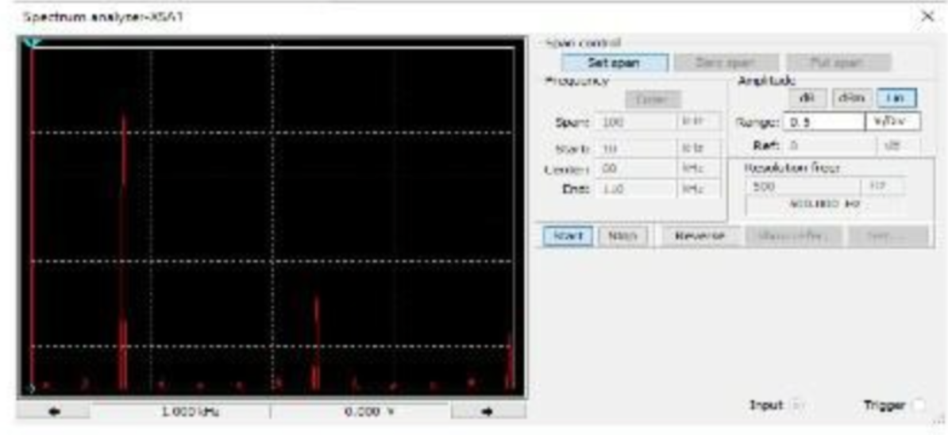
Baseband Signals
The screenshot should show the spectrum analyzer displaying the signal’s harmonic spectrum and its panel settings. Record the signal voltage at each of the frequencies in the table.
Harmonic Frequency | Signal (Volts)
20 kHz | 3.01v
40 kHz | 0.0v
60 kHz | 1.01v
80 kHz | 0.00v
100 kHz | 0.60v

Slide 4
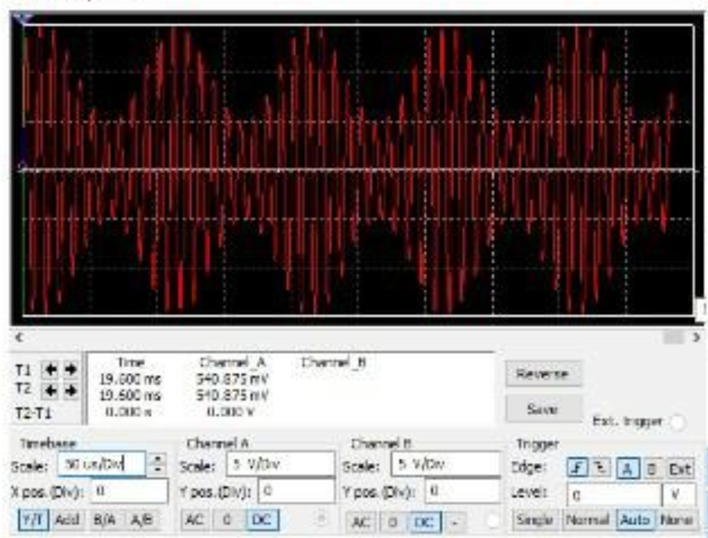
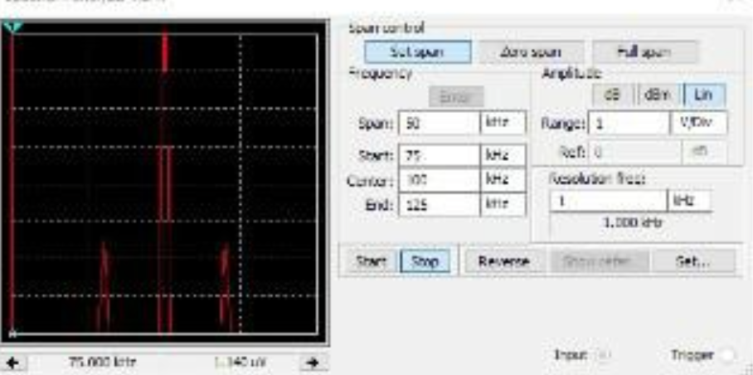
AM Signals
The screenshot of the Oscilloscope should include the signal and the panel settings of the oscilloscope. The screenshot of the Spectrum Analyzer should include the signal and the panel setting of the analyzer.
Oscilloscope screenshot here
Spectrum Analyzer screenshot here
AM Modulation | Frequency (kHz)
Lower side band | 90.0724 KHz
Carrier | 100 KHz
Upper side band | 109.712 KHz

Slide 5
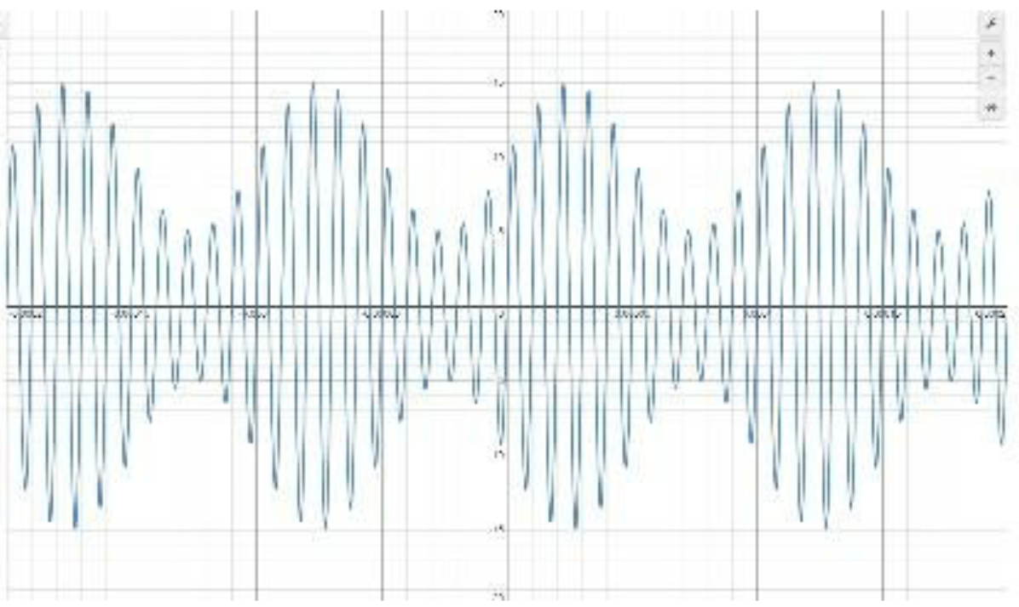
AM Signals Cont.
Develop equations for the carrier and modulating signals and plot the equation for the composite modulated signal V_{AM .}
Equations here: Carrier Signal: v_c(t) = A_c * sin(2πf_c*t)
Modulating Signal : v_m(t) = A_m * sin(2πf_m*t)
Plotted diagram screenshot here:

Slide 6
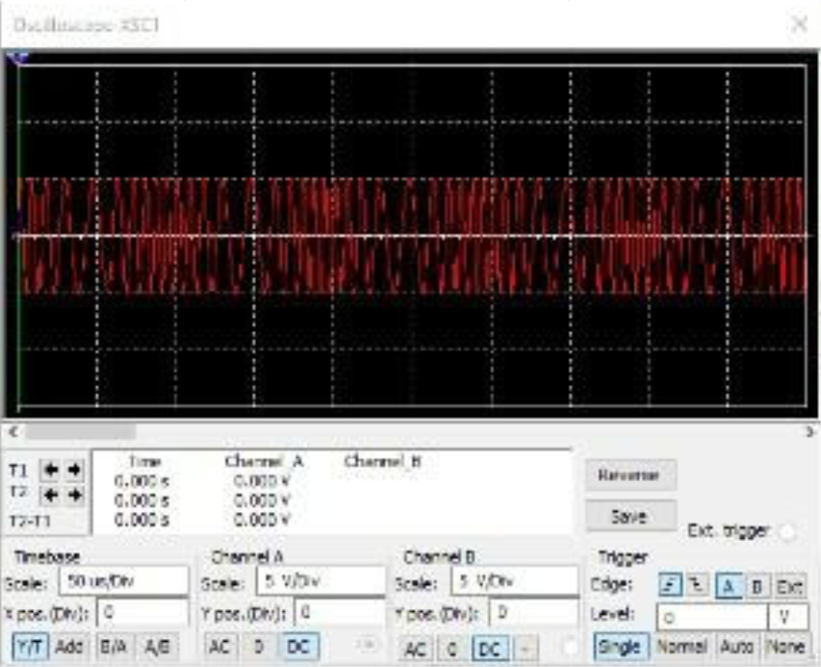
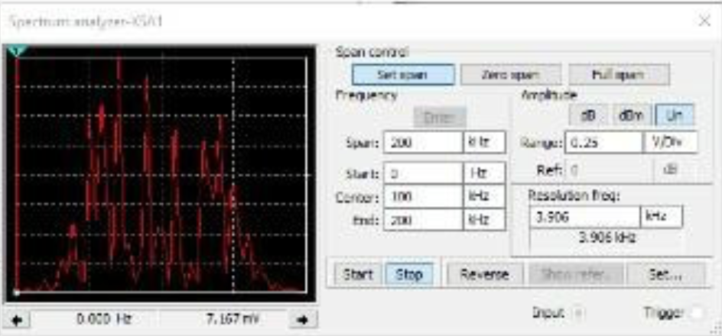
FM Signals
The screenshot of the Oscilloscope should include the signal and the panel settings of the oscilloscope. The screenshot of the Spectrum Analyzer should include the signal and the panel setting of the analyzer.
Oscilloscope screenshot here
Spectrum Analyzer screenshot here
What’s the carrier frequency?
100 KHz

Slide 7

Pulse Code Modulation (PCM) and Line Codes

Slide 8
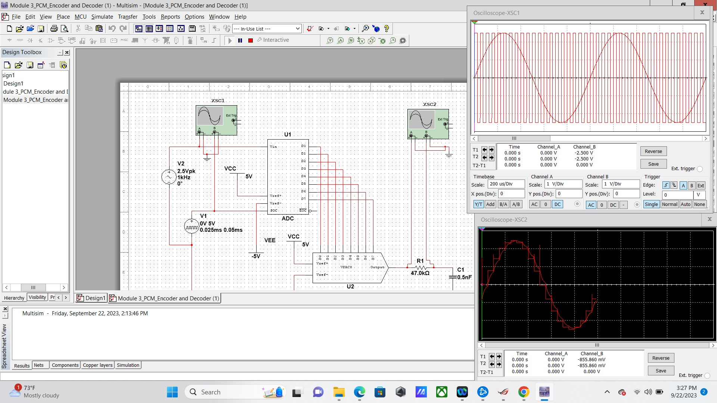
Pulse Code Modulation (PCM)
The first screenshot should show the Oscilloscope-XSC1 display with the analog input signal and sampling clock at the input to the ADC. The second screenshot should show the Oscilloscope-XSC2 display with the output of the DAC.

Slide 9
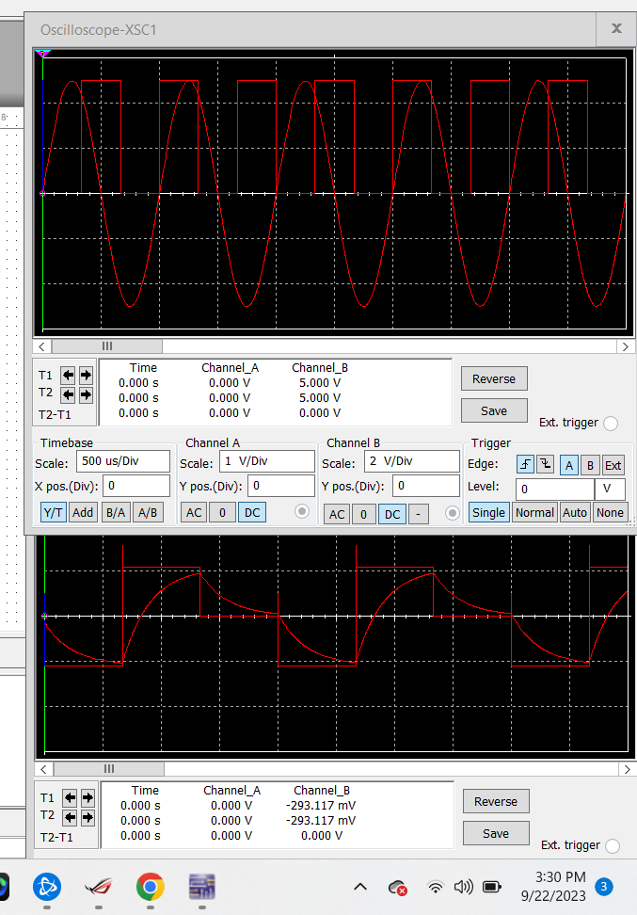
Pulse Code Modulation (PCM)
The first screenshot should show the Oscilloscope-XSC1 display with the analog input signal and sampling clock at the input to the ADC. The second screenshot should show the Oscilloscope-XSC2 display with the output of the DAC.
What are the effects of increasing or decreasing the sampling rate?
Answer:
With the increasing of the sampling rate it would allow you to acquire better signal, while decreasing would do the very opposite to your signal,

Slide 10
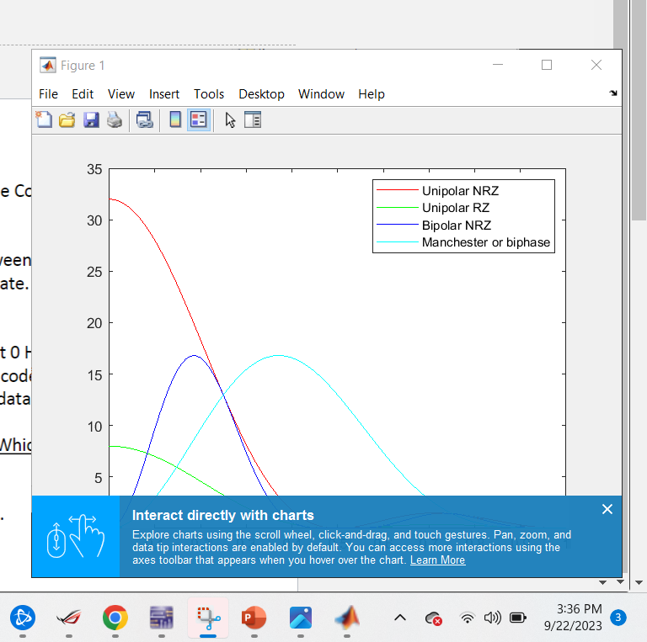
Line Codes
This screenshot should show the power spectral densities of four-line codes: NRZ-Polar, NRZ-Unipolar, NRZ-Bipolar, and Manchester-Polar.
MATLAB Diagram Here
Compare the NBR-Polar and Manchester polar codes in the diagram.
Which one requires more bandwidth?
Answer:
NRZ-UNIPOLAR

Slide 11
References
1.Itprotv.com
2.
3.
……

Slide 12
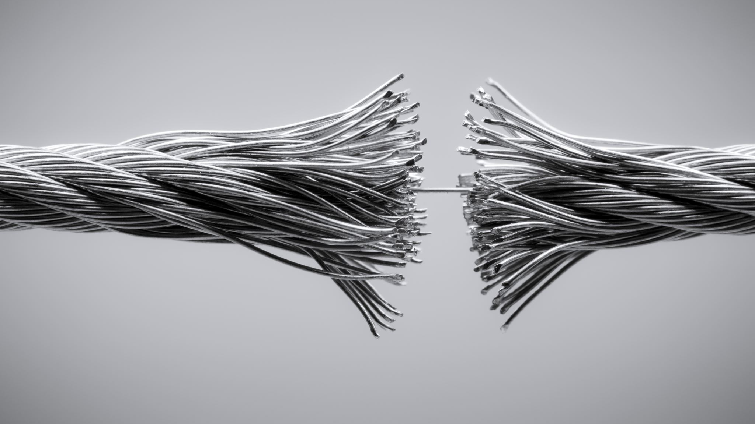
Cables and Structured Cabling

Slide 13
Questions
1. Why must the twisting in the individual wires be maintained in a UTP cable?
Answer:
twisting of individual wires would help reduce the electromagnetic interference.
2. How many inches should UTP cable be separated from 110 volts electrical cable?
Answer:
With separation from UTP cables, a good amount is about 8” on parallel with no know shielded pathway.
3. Horizontal cabling connects what areas to each other?
Answer:
Horizontal cabling would connect work area telecommunication outlets to their desired outputs.

Slide 14
Questions
4. What is a plenum rated cable?
Answer:
Plenum rated cable in a cable with a special insulation that low smoke and flame characteristics, making it very useful for machines like an A/C
5. What is a riser tube used for?
Answer:
Riser tube is used for the vertical running of wiring through buildings to allow wiring to go to different floors while staying clear of eyesight .
6. Is the grounding of equipment mostly a safety or a performance concern?
Answer:
Grounding equipment is mostly a safety concern especially dealing with electrical safety in mind

Slide 15
References
1.Class Textbook
2.
3.
…

Slide 16
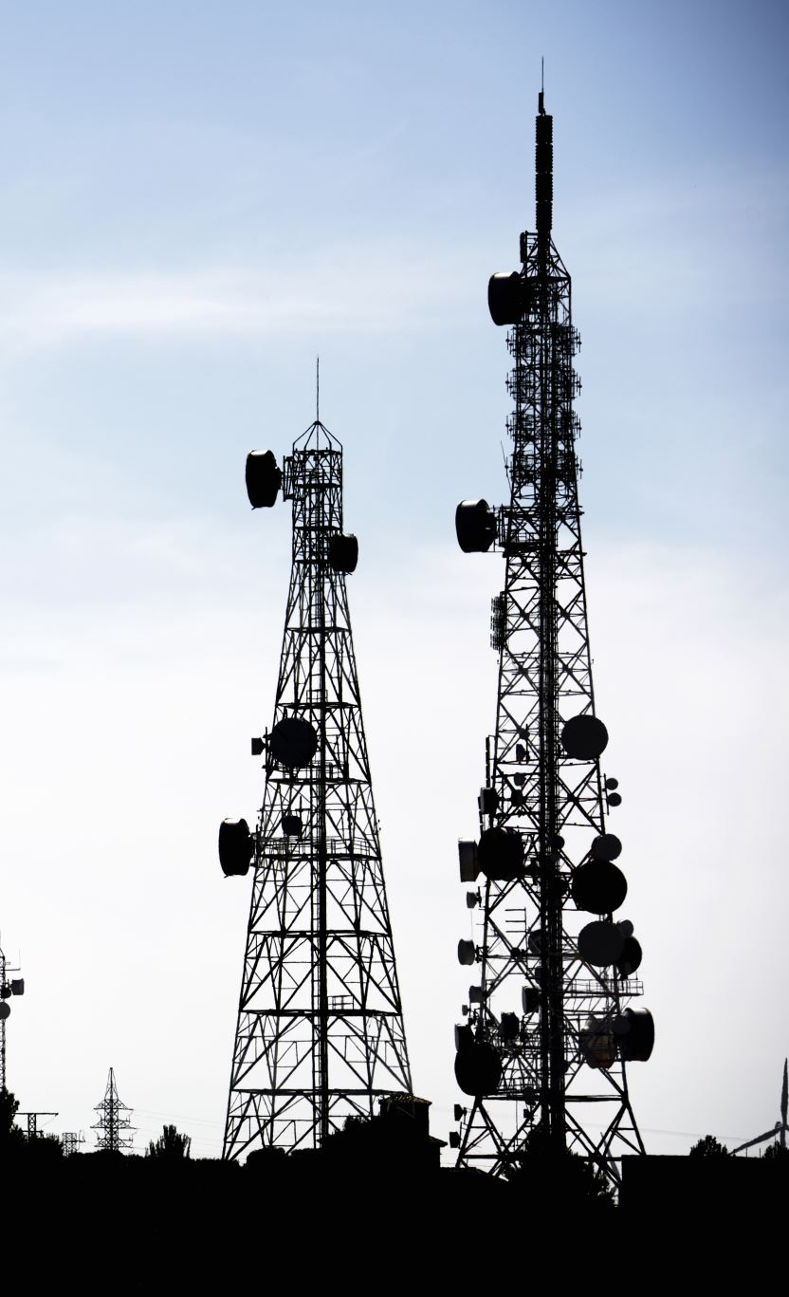
Antenna Gain and Free Space Path Loss

Slide 17
Antenna Gain
1. What is the maximum theoretical antenna gain of a common dish antenna at the 2.4 GHz band? [4 points]
Answer: 23.379
2. What is the maximum theoretical antenna gain of a common dish antenna at the 5 GHz band? [4 points]
Answer:29.079
3. Given the same sized reflector, which signals, high-frequency, or low-frequency, can be more efficiently focused by a common dish antenna (i.e., result in a higher antenna gain)? [5 points]
Answer: Higher Frequency
4. What is the maximum theoretical antenna gain of the dish antenna used in the VLA radio telescopes in New Mexico at the 5 GHz band? [4 points]
Answer:63.059
5. Given the same signal frequency, which dish antennas, large-sized or small-sized, are more efficient at focusing the signal (i.e., result in a higher antenna gain)? [5 points]
Answer: Large sized , the more gain an atenna has the more directive it is.

Slide 18
Free Space Path Loss
1. What is the free space path loss in dB at the 2.4 GHz band? [4 points] Answer:-80.4
2. What is the free space path loss in dB at the 5 GHz band? [4 points] Answer:87.2
3. How does the free space path loss at a higher frequency (e.g., the 5 GHz band) compare with that at a lower frequency (e.g., the 2.4 GHz band)? [5 points]
Answer: a higher loss at higher frequency
4. What is the free space path loss in dB over 20 meters at the 2.4 GHz band? [4 points]
Answer: -66.421
5. What is the free space path loss in dB over 40 meters at the 2.4 GHz band? [4 points]
Answer:-72.441
6. What is the free space path loss in dB over 80 meters at the 2.4 GHz band? [4 points]
Answer:-78.462
7. When the distance doubles, how does free space path loss in dB change approximately? [5 points]
Answer: it consistently fell by 6.02 dB

Slide 19

Free Space Path Loss Cont.
8. Use a scientific calculator to calculate Delta $L_{fS}$ for D1 = 20 meters and D2 = 40 meters. [4 points]
Delta $L_{fS }$= _____-6.021______
9. Is your calculation approximately the same as the result from Part 1 Step 2? [4 points]
Answer: no

Slide 20

Bit Error Rate of Fading Channels

Slide 21
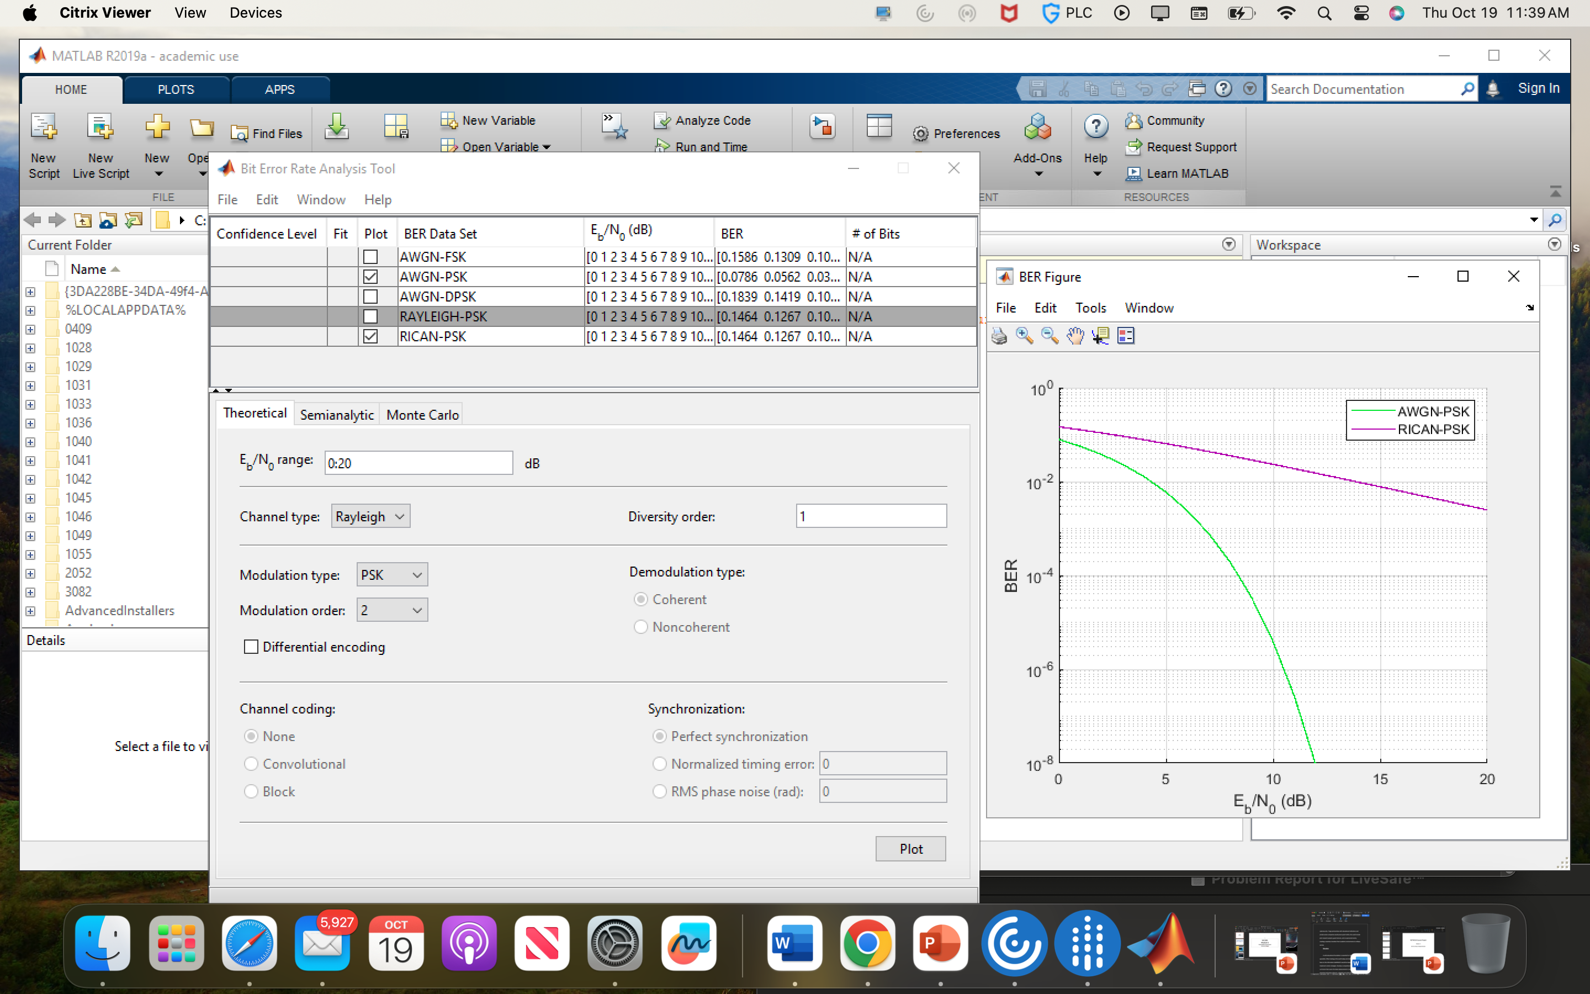
AWGN Channel and Rician Channel
This screenshot should show the bit rate error performance of both AWGN and Rician fading channels.

Slide 22
AWGN Channel and Rician Channel
Compare and contrast the BER performance of PSK over a noise limited (AWGN) transmission channel to the performance of PSK over a Rician channel at 5- and 10-dB Signal to Noise Ratio (E_{b}/N₀), respectively.
Is there a significant difference in BER performance of PSK between the AWGN channel and Rician channel?
Answer: The lowest bit error rate is 16PSK. The BER point of view, AWGN channel is better than
multipath Rayleigh faded channel. Meaning, it has the bit error rate is less at the multipath Rayleigh faded and the bit error rate is large for 10dB

Slide 23
Challenges
For me the biggest challenges was getting citrix to work in the beginning , I was also challenged because these ideas are very foreign to me, but it help to open my eyes to wired technologies as a whole .

Slide 24
Career Skills
As an inspiring Cyber professional, it is very important to understand all hardware technology and what makes them work and function and where could their compromise come from it has opened the door for me to look at infrastructure security in the near future .

Slide 25
Conclusion
In conclusion I am happy with the material covered and feel it has made me a better technology professional going through this class .

Slide 26
References
1.Citrix .
2. Itprotv.net
3. Github.com
4. Class textbook
5.cybrary.com
……

