Slide 1
Introduction
The technology around us is growing at an expondential rate . New process and applications are being developed consitently , this creates an environment of constant learning and new employment oppurtinties avalble that where not in the past. Knowing how to install, configure and troubleshoot a computer network is a very marketable skill , and my project will demonstrate just that and some more.

Slide 2
Hardware and software Preparation
Installed VM Workstation
Installed Ubuntu virtual machine
Configured router to enable DHCP and WLAN
Implemented network support IPv4 and IPv6

Slide 3
Final Project
IPv4 & IPv6 Addressing

Slide 5
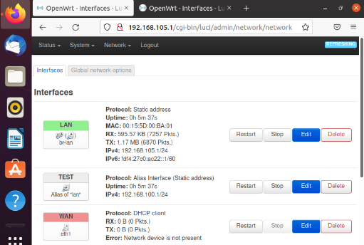
IPv4 Address Assignment

Slide 6

Connectivity Test

Slide 7
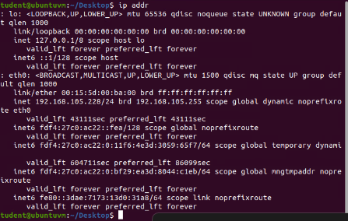
Dynamic IP Address Assignment

Slide 8
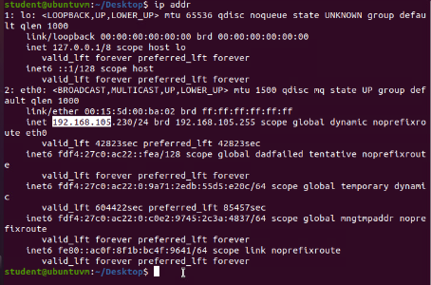
This screenshot shows the IPv4 address of the Computer 2 VM

Slide 9
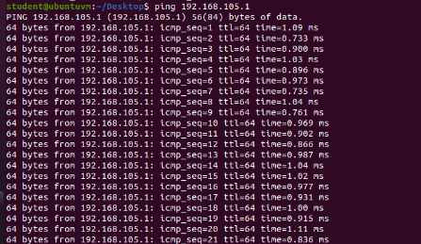
Connectivity test

Slide 10

This screenshot shows the connectivity tests between the Computer 2 VM and the other two devices (i.e., the SOHO Router VM and Computer 1 VM).

Slide 11
IP Subnetting and Loopback Interfaces

Slide 12
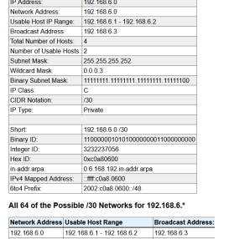
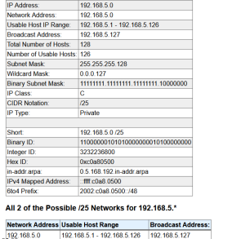
Subnetting table

Slide 13
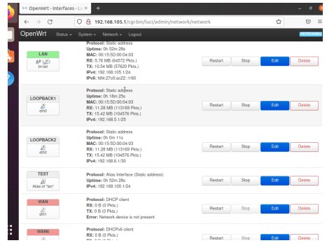
Loopback interfaces

Slide 14
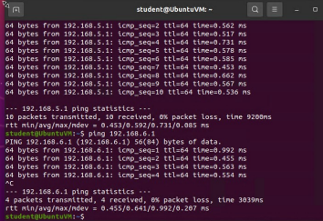
Connectivity Test

Slide 15
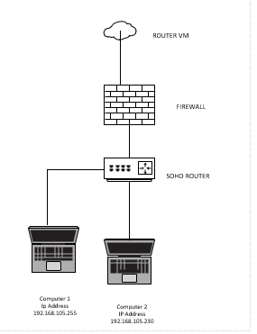
Microsoft Viso Diagram

Slide 16
SOHO Wireless Network Security
1. What are the factory default username and password of a TP-Link router? Why is it important to change the default username and password of a SOHO router?
Answer:
The default username is admin, password is also admin.
It is important to change the default password for security purposes .
2. To protect a SOHO wireless network with a small number of devices, which address management method provides more control, configuring the device IP addresses manually (static IP) or using a DHCP server (dynamic IP)? Why?
Answer:
I think that the address management method that provides more control, configuring the devices ip address manually is a static ip addresses . It does require manual configuration.
3. What does MAC filtering do? If needed, when would you use deny filtering rules and when would you use allow filtering rules? What happens to devices that want to connect, if the “Allow the stations specified by any enabled entries in the list to access” function is enabled but there are no entries in the list?
Answer: MAC filtering allows you to control the wireless access in the network . if I know the device I will use the allow filter rules. If it’s a device I do not know I will use the deny filtering rules . If a device want to connect and “allow the stations specified by any enabling entries in the access list function is enabled the device will not be allowed to the access point.

Slide 17
SOHO Wireless Network Security
1. What wireless security settings are displayed on the Wireless Security page? Which one is recommended by the vendor? Why?
Answer:
The wireless security settings that are displayed on the Wireless Security page are WPA/WPA2
Personal, WPA/WPA2 Enterprise and WEP.
The wireless security setting recommended by the vendor was the WAP2 PSK AES because it have
more advanced encryption than the TKIP.
2. Among the configurations you explored in this module, which one is a true security function? Why?
Answer:
I believe that one security function in this module was the Wi-Fi security configuration
because of the AES encryption method.
3. What would you do to protect your wireless network at home? Why?
Answer:
I would change the username and password, turn on
the wireless network encryption and turn off the Wi-Fi network when I'm not at home

Slide 18

Challenges & Conclusion

Slide 19
Challenges Final project
Some Challenges I faced where understanding subnetting
Working in the interface and getting the correct IP address I was looking for

Slide 20
Conclusion
After completing this project , I learned how basic and complex networking are done from everything from a basic small home router to a 800-computer network and more.
I also learned the importance of what kind of cables you should be using depending on the network and all the tools that are used to trouble shoot signal and cable issues

