Slide 1
NETW211 Final Deliverable
Fundamentals of Cloud Computing
Zachary Clerge

Slide 2
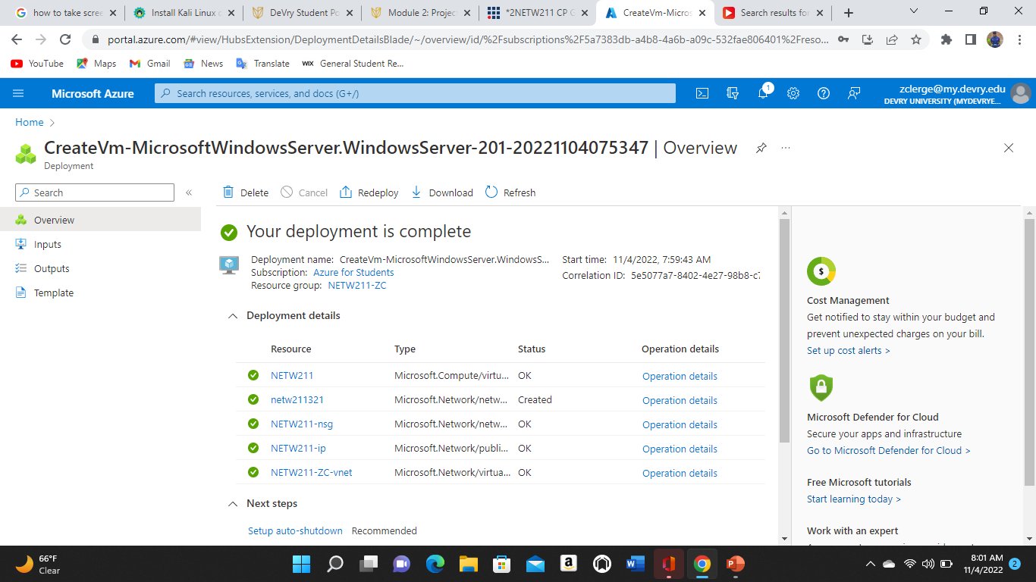
Deploying a VM in Azure

Slide 3
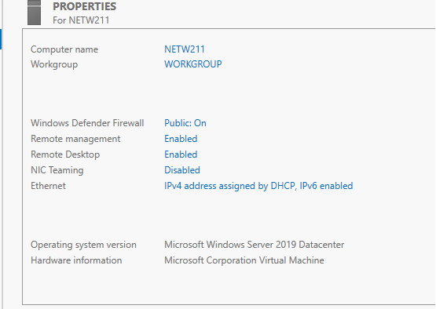
Connecting to the VM

Slide 4
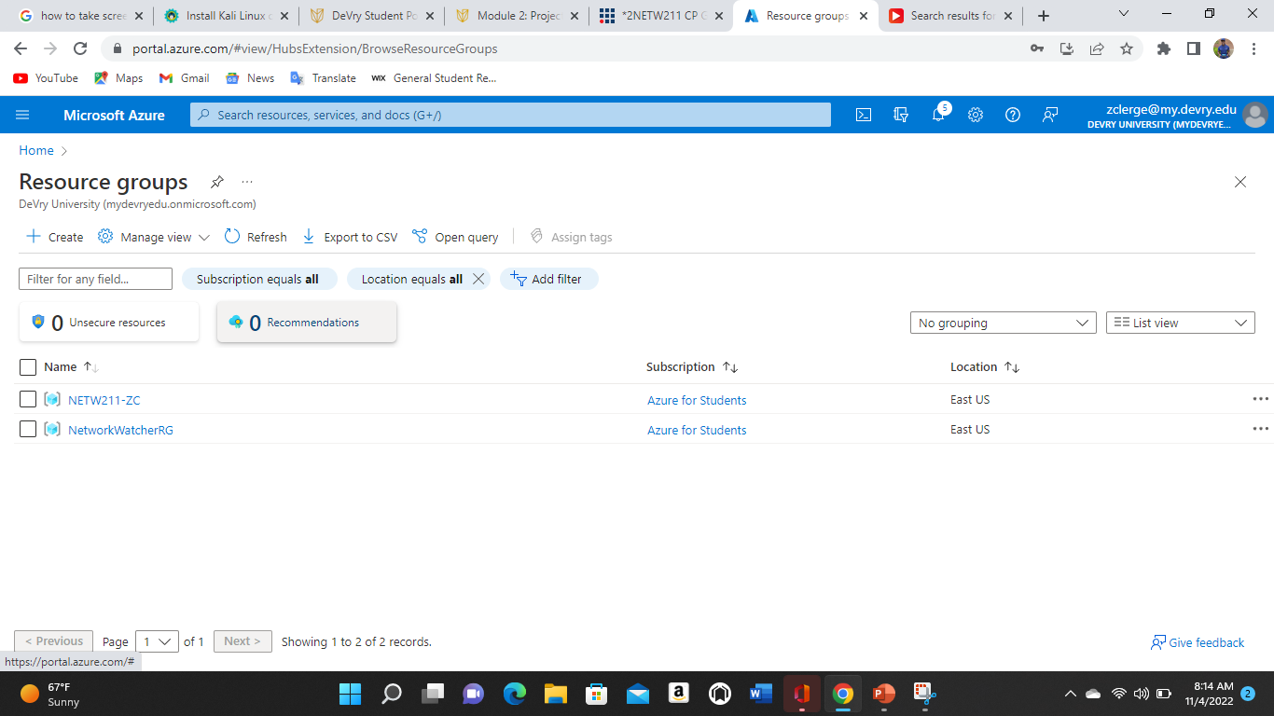
Deleting
the VM

Slide 5
Azure VNet and Subnets

Slide 6
Creating a VNet with Two Subnets
1. With a /24 network prefix, how many usable IPv4 host addresses are there? [hint: you learned this in NETW191]
Answer here:
Out of all 256 IPs in this /24 subnet, only 253 can be used.
2. Given the answer above, why is the number of available IP addresses for Subnet0 (10.0.0.0/24) or Subnet1 (10.0.1.0/24) shown as 251? [hint: where did the missing addresses go?]
Answer here:
References (here are two examples to get your research started):
1. IP Subnet Calculator, https://www.calculator.net/ip-subnet-calculator.html
2. Azure Virtual Network frequently asked questions, https://docs.microsoft.com/en-us/azure/virtual-network/virtual-networks-faq
3.
4.

Slide 7
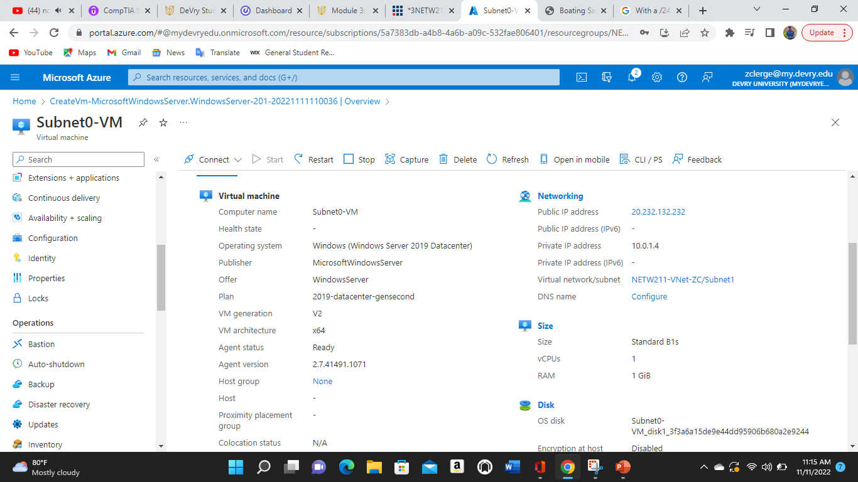
Deploying VMs into Subnets
This screenshot should show the Properties section of the Subnet0-VM page, showing the networking and size information of the VM.

Slide 8
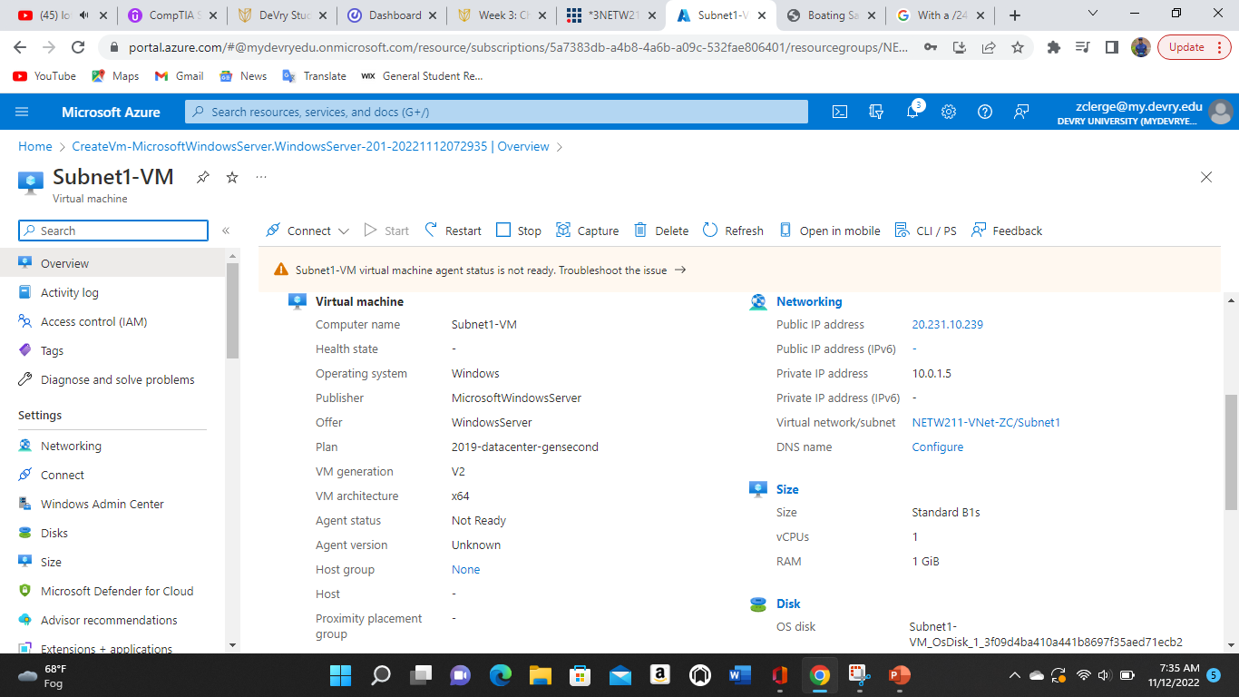
Deploying VMs into Subnets cont’d
This screenshot should show the Properties section of the Subnet1-VM page, showing the networking and size information of the VM.

Slide 9
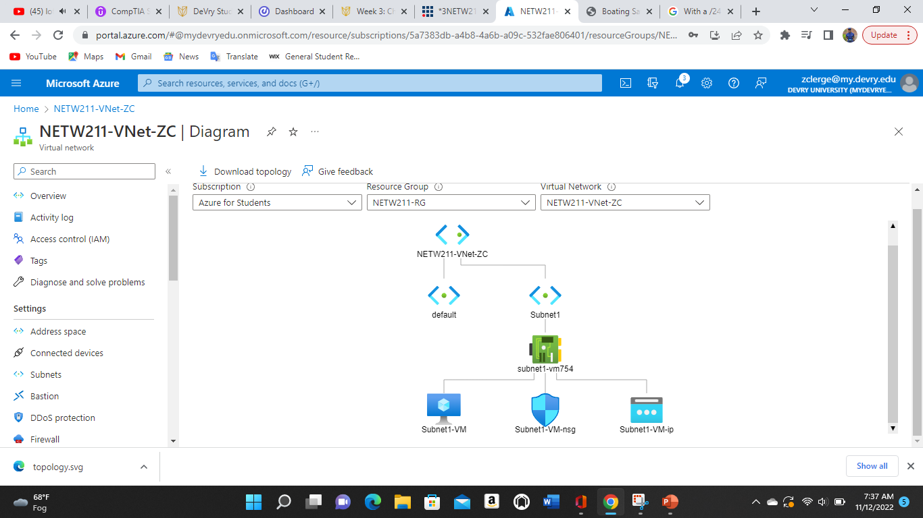
Deploying VMs into Subnets cont’d

Slide 10
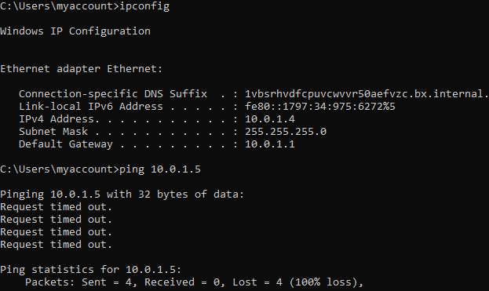
Verifying Connectivity between VMs
.

Slide 11
Verifying Connectivity between VMs
.

Slide 12
Verifying Connectivity between VMs
cont’d
.

Slide 13
Azure VM Security

Slide 14
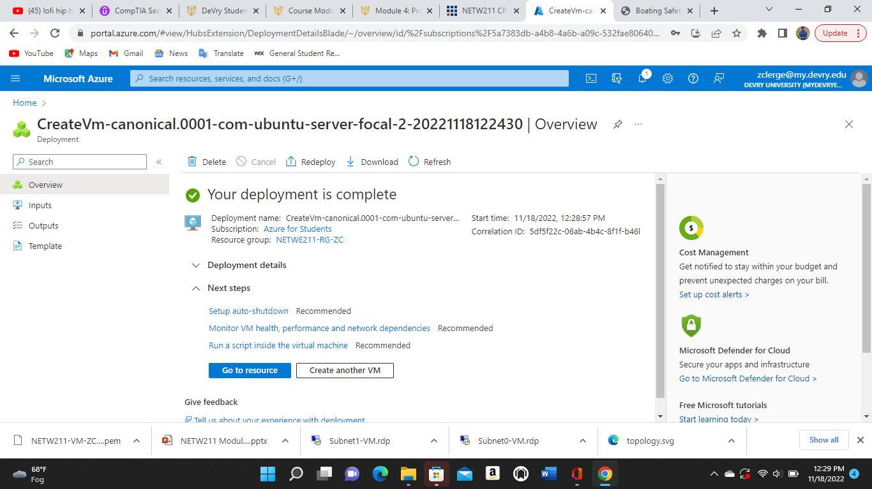
Launching a VM
This screenshot should show the NETW211-VM-Your Initials page, with information such as the resource group name, subscription, public IP address, etc.

Slide 15
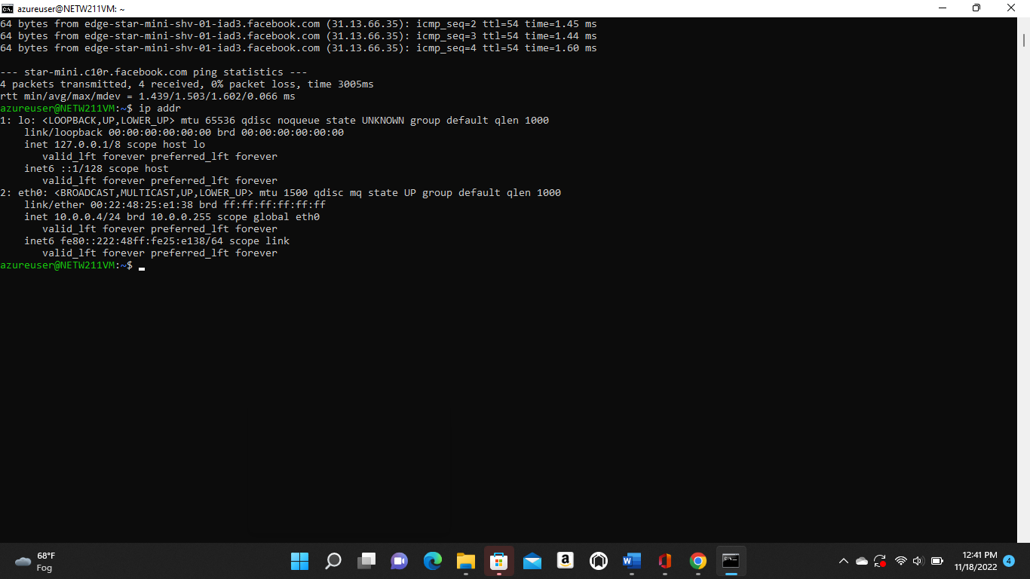
Connecting to the VM
via SSH

Slide 16
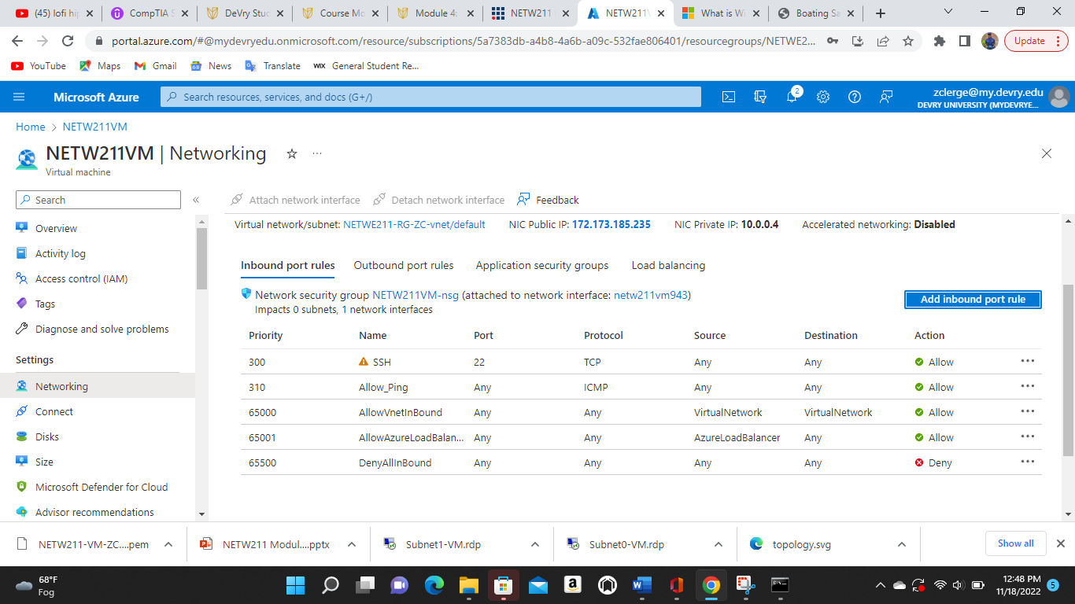
Configuring an NSG

Slide 17
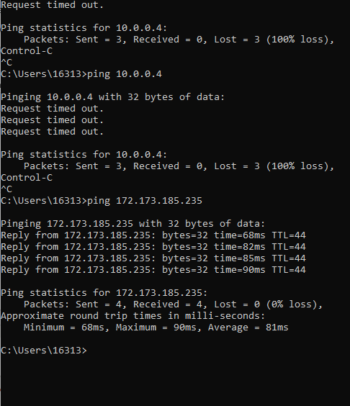
Configuring an NSG
cont’d

Slide 18
Cloud Storage

Slide 19
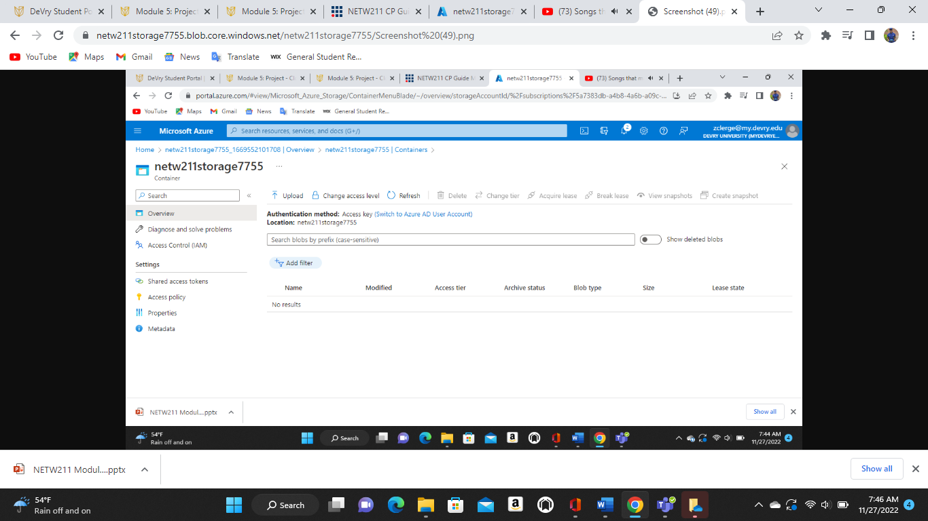
Uploading and Accessing a File

Slide 20
Question
What does the access tier setting do? What are the Azure blob storage access tiers?
[hint: in the Azure portal, on the Upload blob page, under Advanced, click the ? circle above the Access tier box.]
Answer here:
Optimize storage costs by placing your data in the appropriate access tier.
References (here are two examples to get your research started):
1. Hot, Cool, and Archive access tiers for blob data, https://docs.microsoft.com/en-us/azure/storage/blobs/access-tiers-overview
2. Azure Blob Storage Access Tiers, https://devry.percipio.com/courses/c7ef0333-8560-403f-a004-9c5c843866b0/videos/2658bbe6-ee97-438b-a376-fbb079c3b3a0

Slide 21
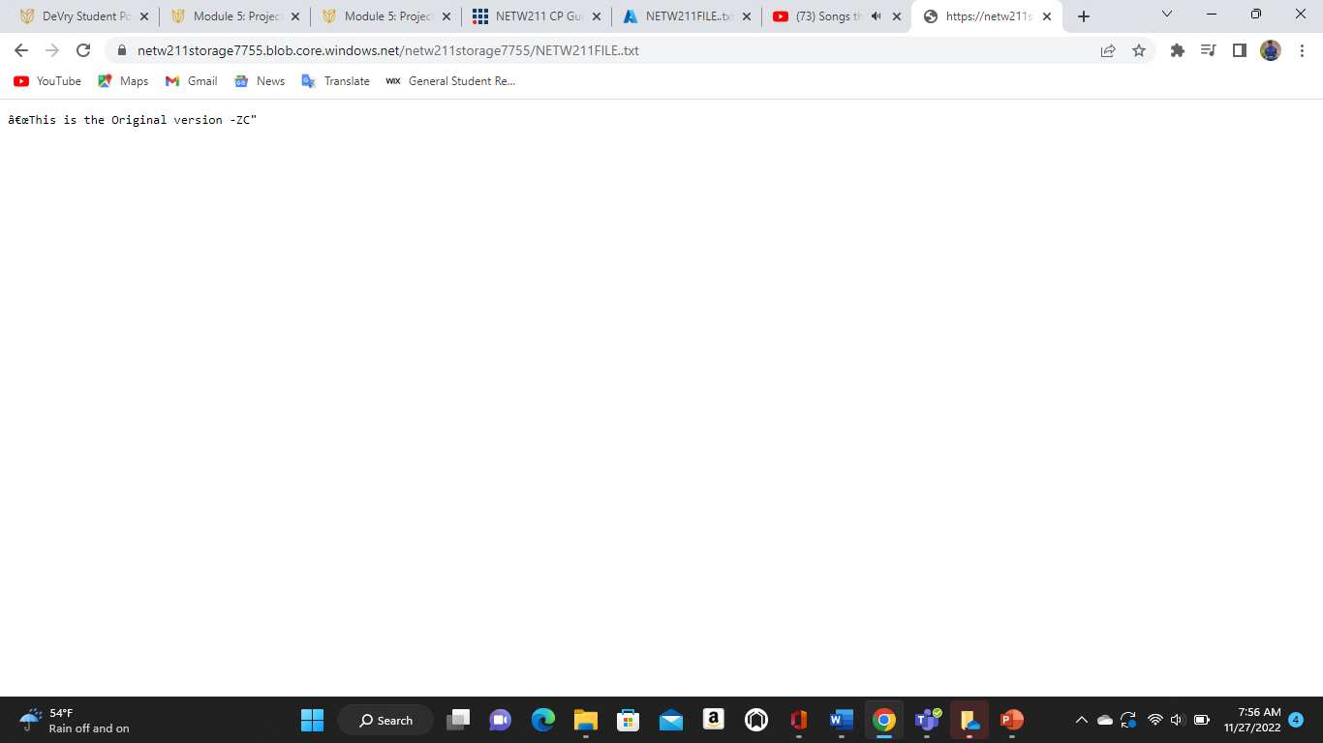
Creating Blob Snapshots

Slide 22
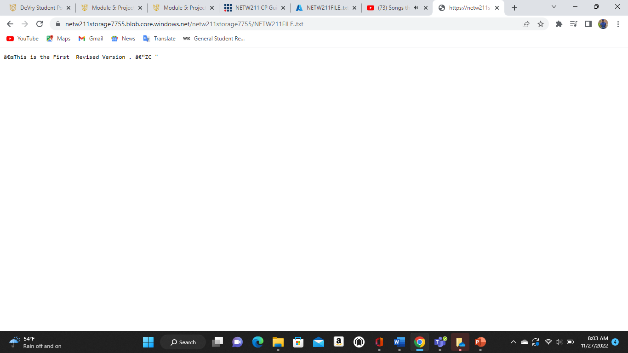
Enabling Blob Versioning
.

Slide 23
Cloud Monitoring

Slide 24
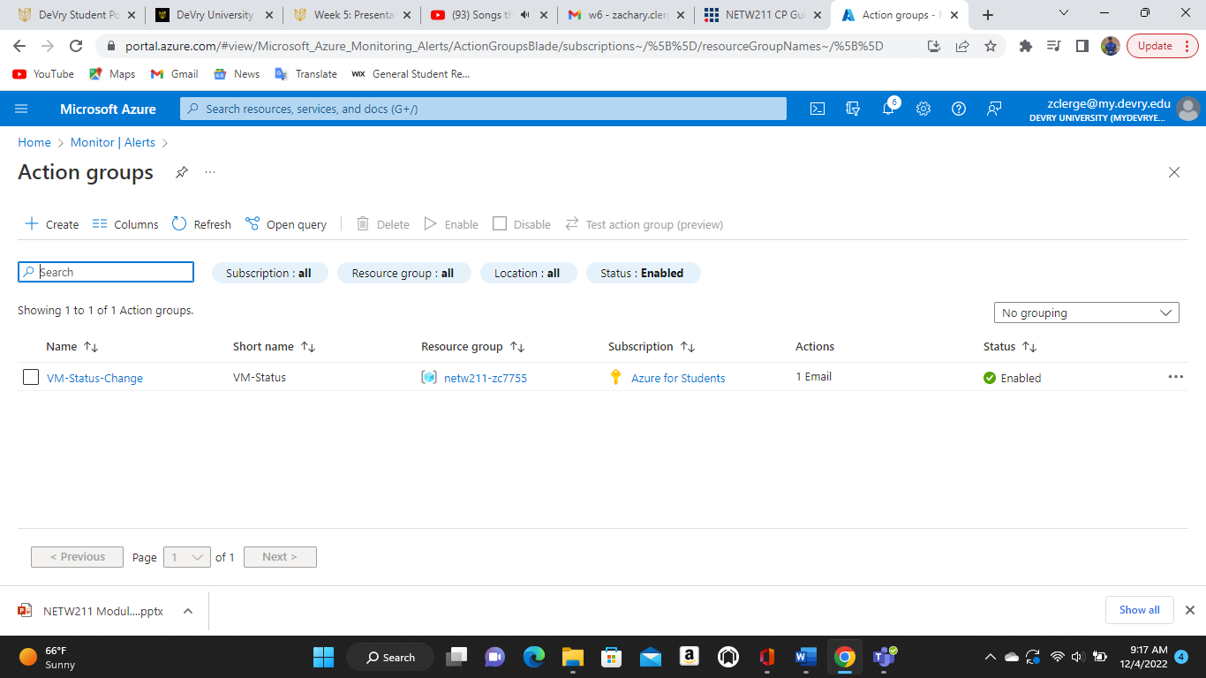
Setting up an Action Group and Notifications

Slide 25
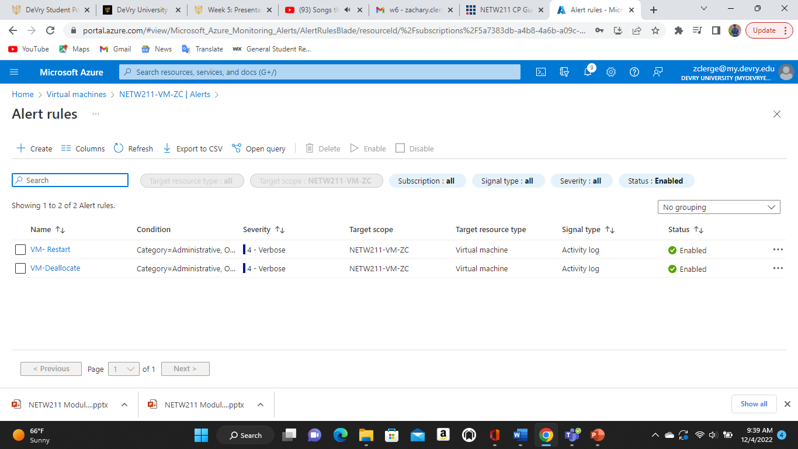
Setting up Alert Rules
.

Slide 26
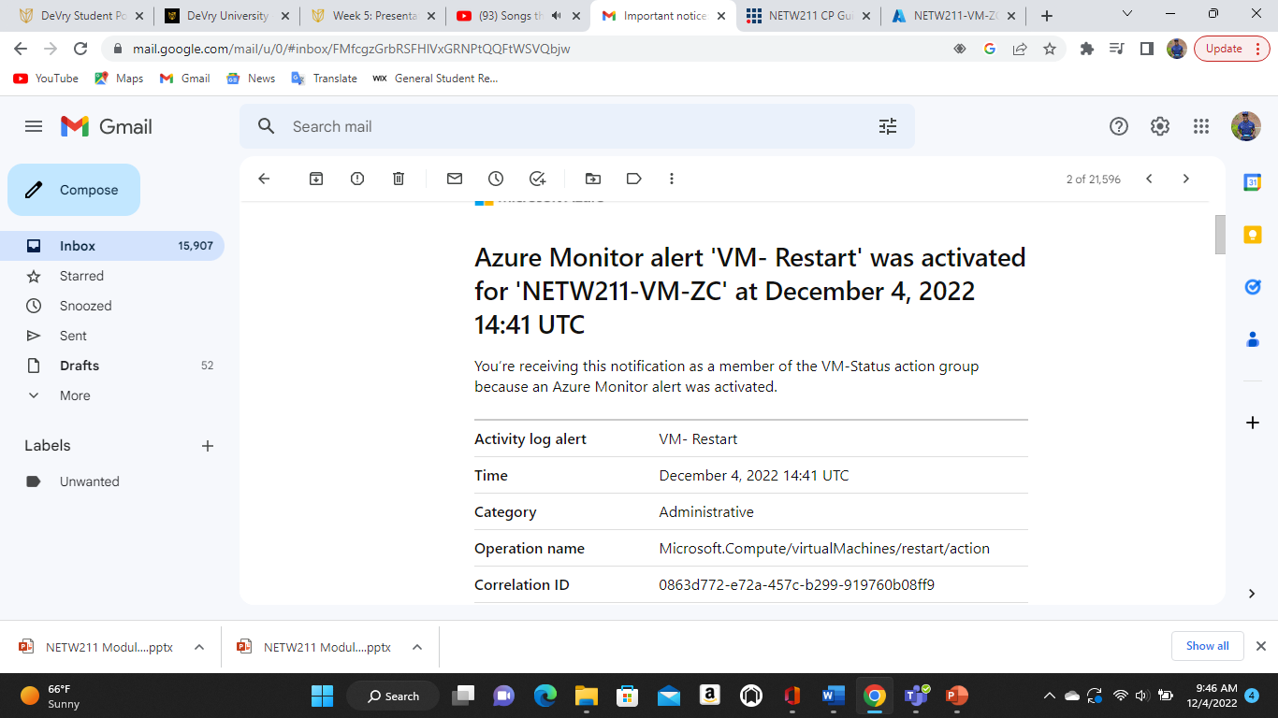
Testing Alerts

Slide 27
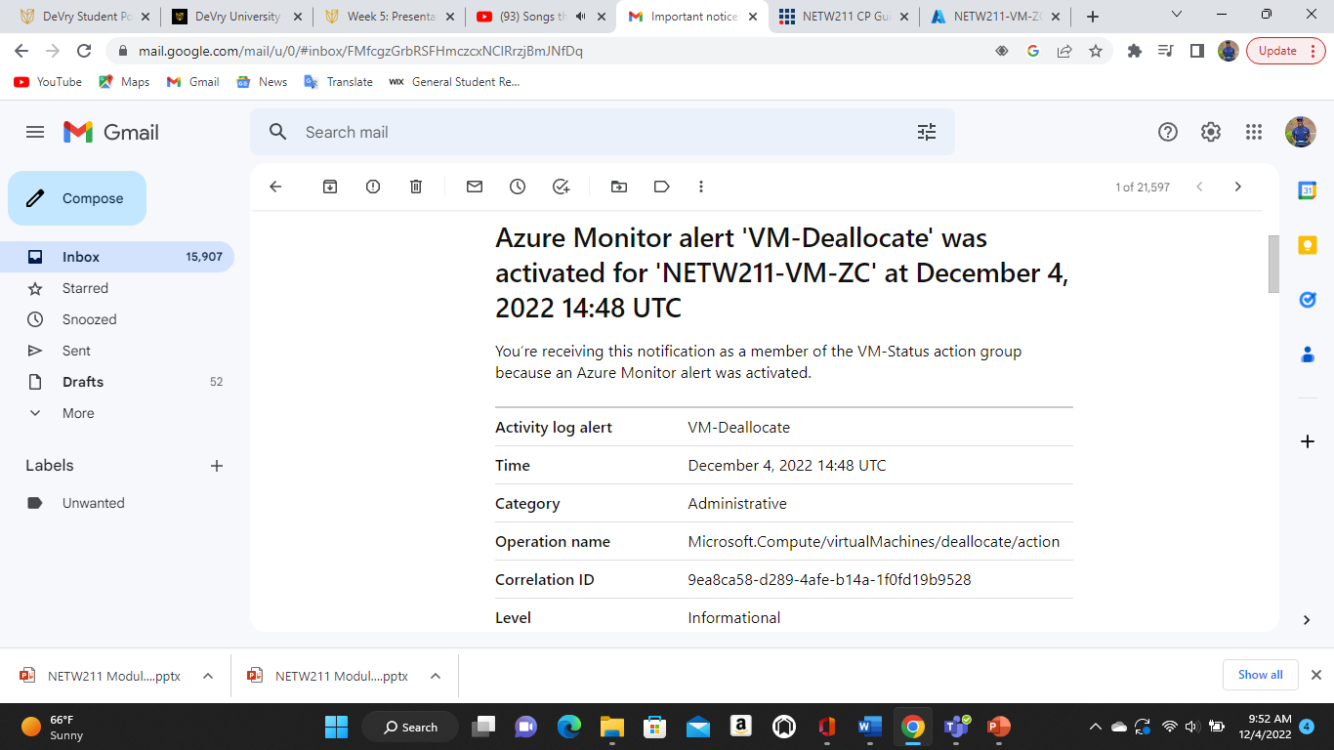
Testing Alerts CONT’D
.

Slide 28
Challenges
For me the only major challenge was getting comfortable in the azure cloud environment the more time I spent on there the more practical knowledge I gained

Slide 29
Career Skills obtained
Understood cloud computing
Explained the virtualization of networking
Examined network services on a cloud platform
Identified cloud-centric access control techniques
Assessed cloud-centric security language
Evaluated cloud storage techniques
Applied common cloud maintenance tools, techniques, and services
Explored the evolving job market in the digitized world
Produced a network on a cloud platform

Slide 30

References
Devry Learning Management Portal
ITPROTV
Cyberwire.com

