Slide 1

CEIS 114 final project
April 2023
Zachary Clerge

Slide 2
Module 2
GATHER PROJECT INVENTORY INSTALL ARDUINO ON COMPUTER INSTALL DOIT_DEVKIT BOARD IN ARDUINO IDE MOUNT ESP32 ON BREADBOARDS

Slide 3
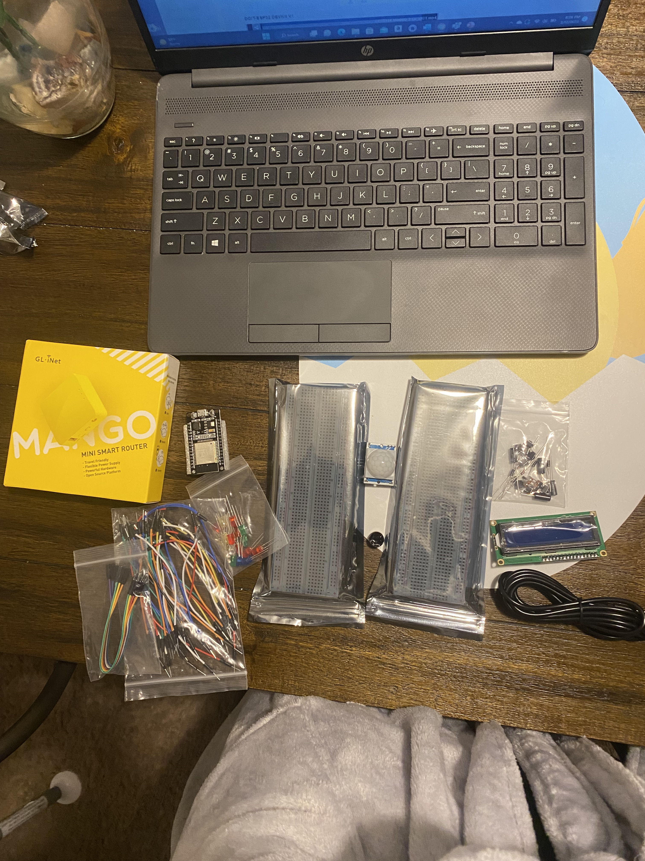
Inventory (Picture)
ESP 32 Board
Colored LEDs: Red, Yellow, Green, and Blue
220 Ohm Resistors (optional)
Wires
Breadboard(s)
LCD Unit with I2C Adapter
Active Buzzer
Mini Router
Push Button(s)
PIR Motion Sensor

Slide 4
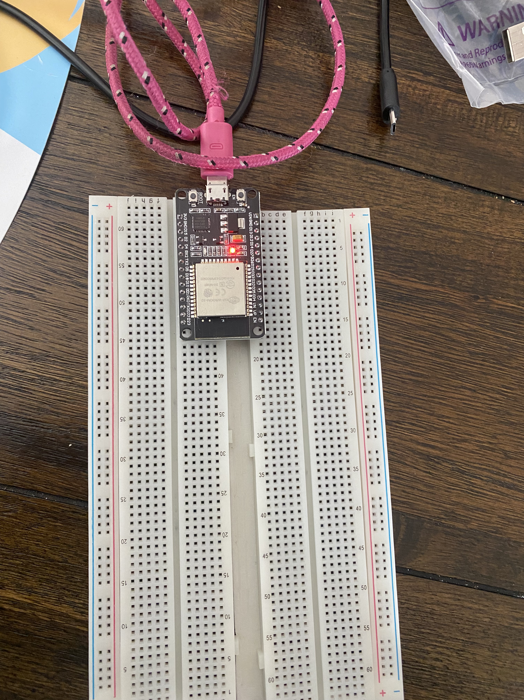
ESP32 (Picture)
Microcontroller mounted and powered ON

Slide 5
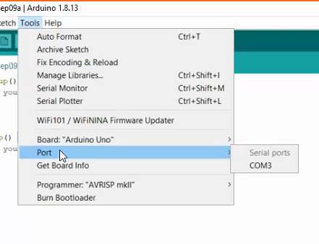
Installation of Arduino IDE
Screenshot of Arduino IDE with Port selected from Tools menu.
Example

Slide 6
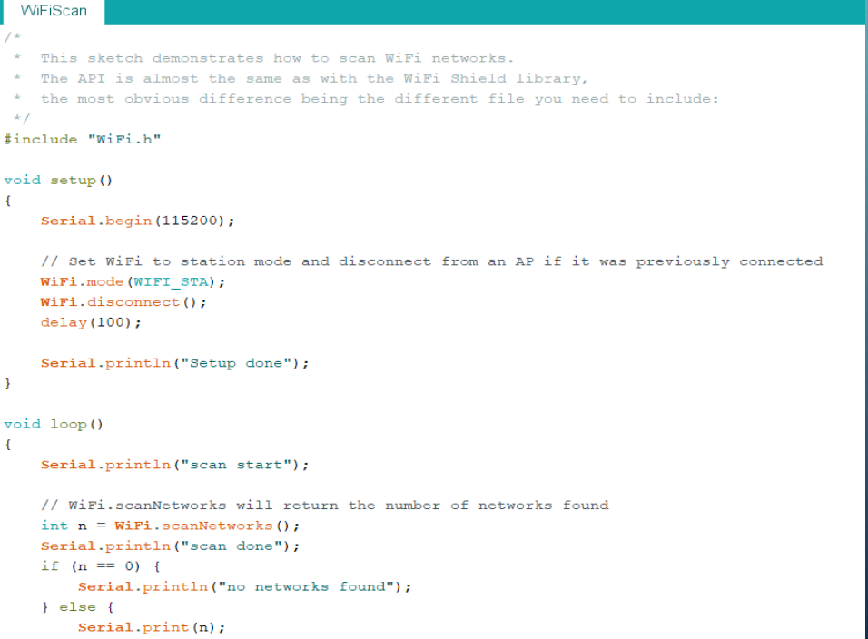
ESP32 WiFi Scan
Screenshot of Serial Monitor in Arduino IDE showing the available networks

Slide 7
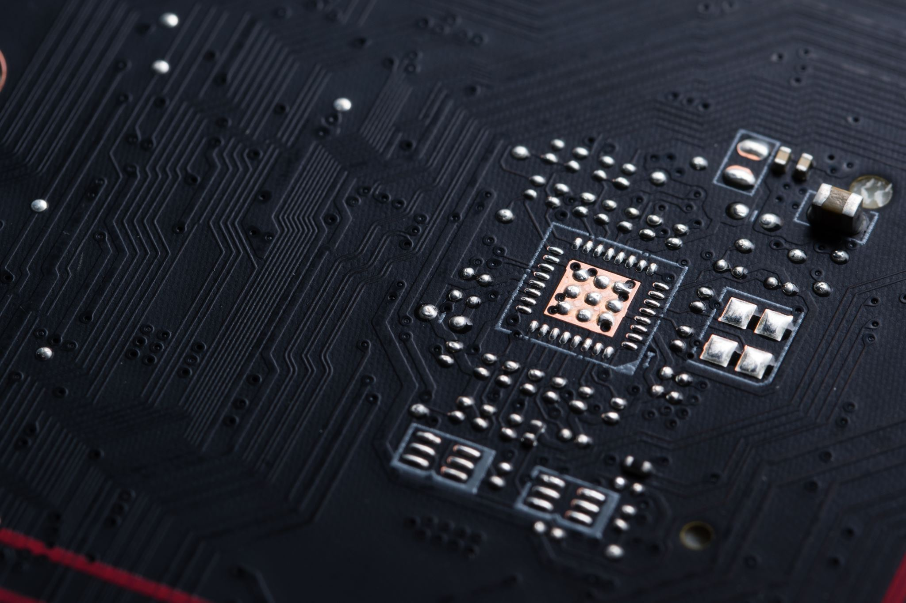
CEIS 114
Module 3
Creating the Traffic Controller
Zachary Clerge

Slide 8
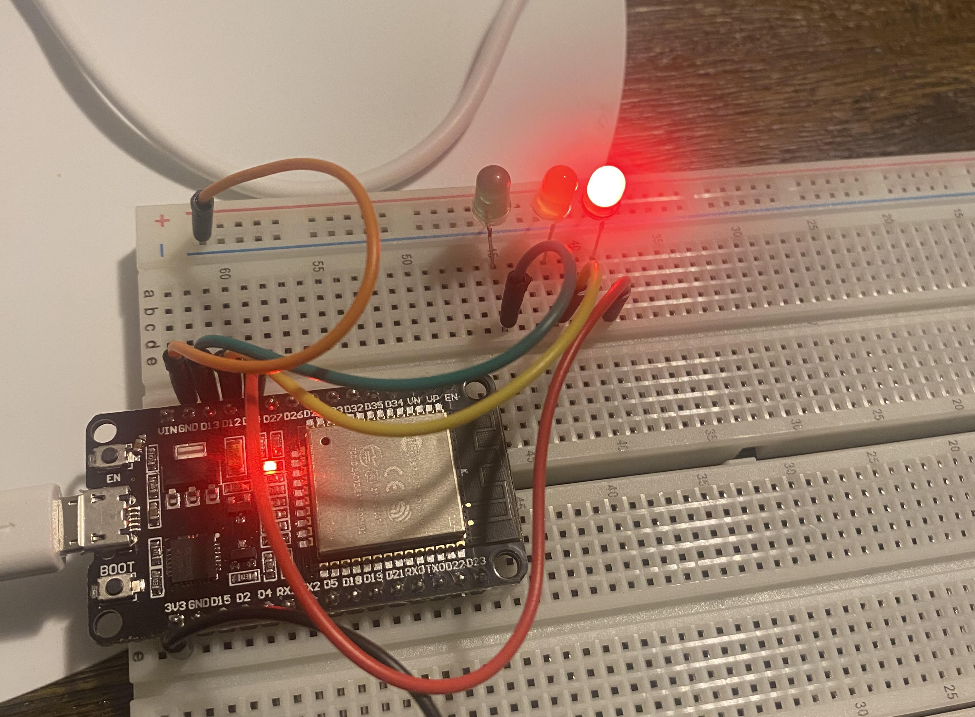
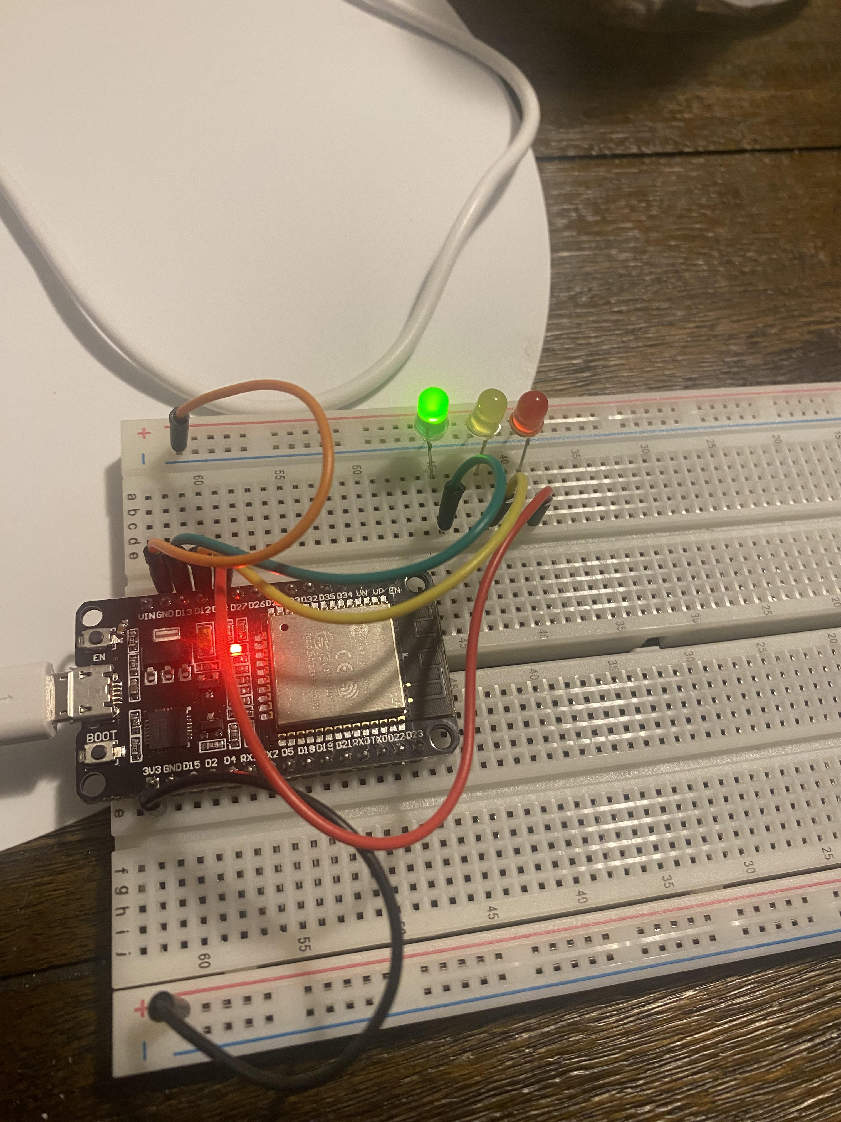
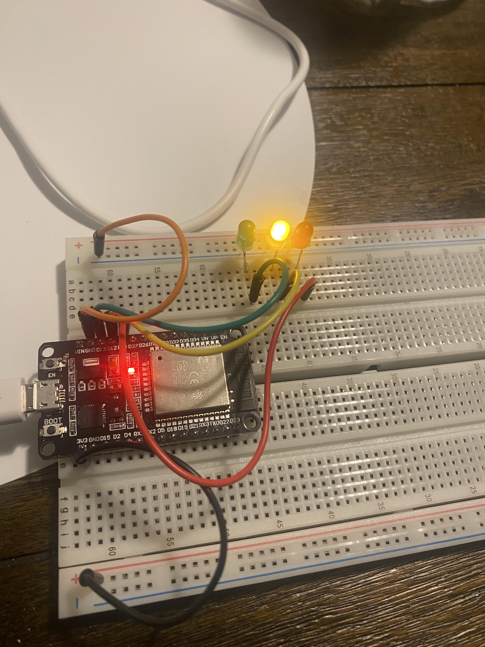
Picture of circuit with working LEDs
ESP 32 Board
Colored LEDs: Red, Yellow and Green
220 Ohm Resistors (optional)
Wires
Breadboard

Slide 9
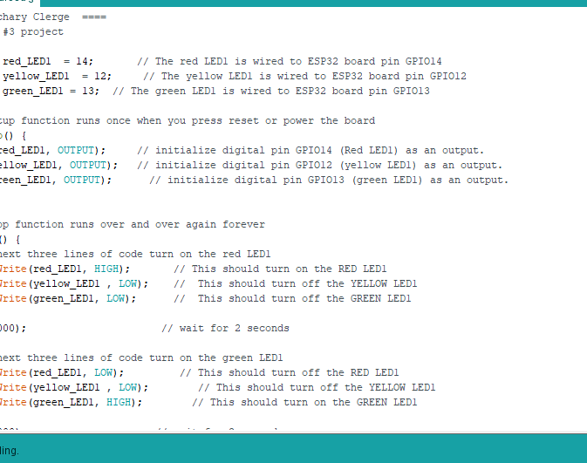
Screenshot of code in Arduino I
Screenshot of code in Arduino IDE showing your name in the comment

Slide 10
CEIS 114
Module 4
Creating a Multiple Traffic Light Controller
Zachary Clerge

Slide 11
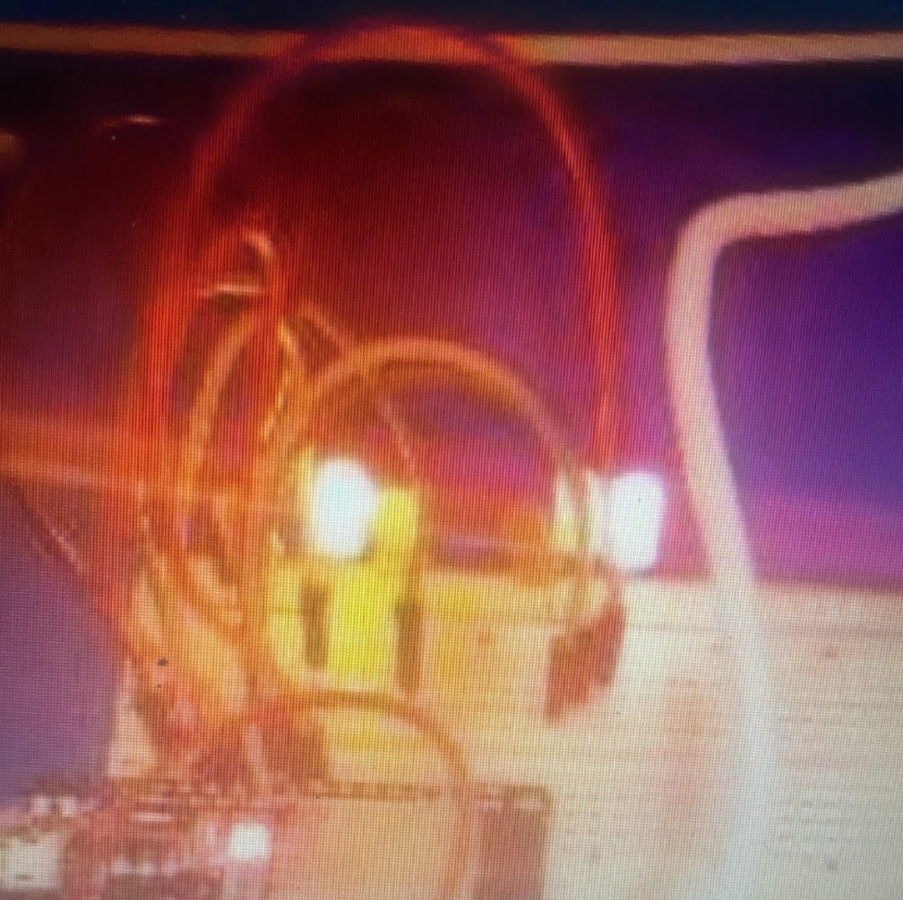
Picture of circuit with working LEDs
ESP 32 Board
Colored LEDs: Red, Yellow and Green (two sets)
220 Ohm Resistors (optional)
Wires
Breadboard

Slide 12
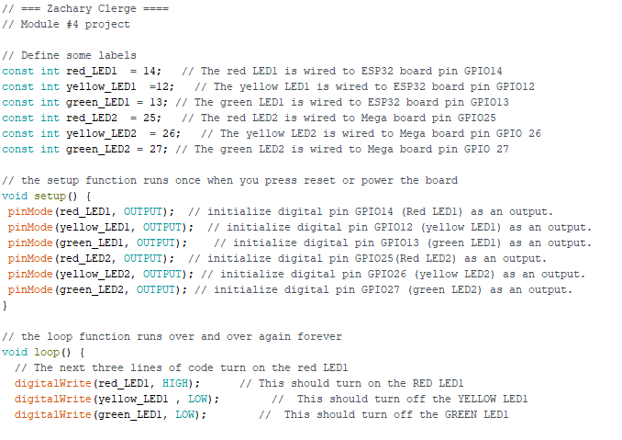
Screenshot of code in Arduino IDE
Screenshot of code in Arduino IDE showing your name in the comment

Slide 13
CEIS 114
Module 5
Creating a Multiple Traffic Light Controller with a Cross Walk
Zachary Clerge

Slide 14
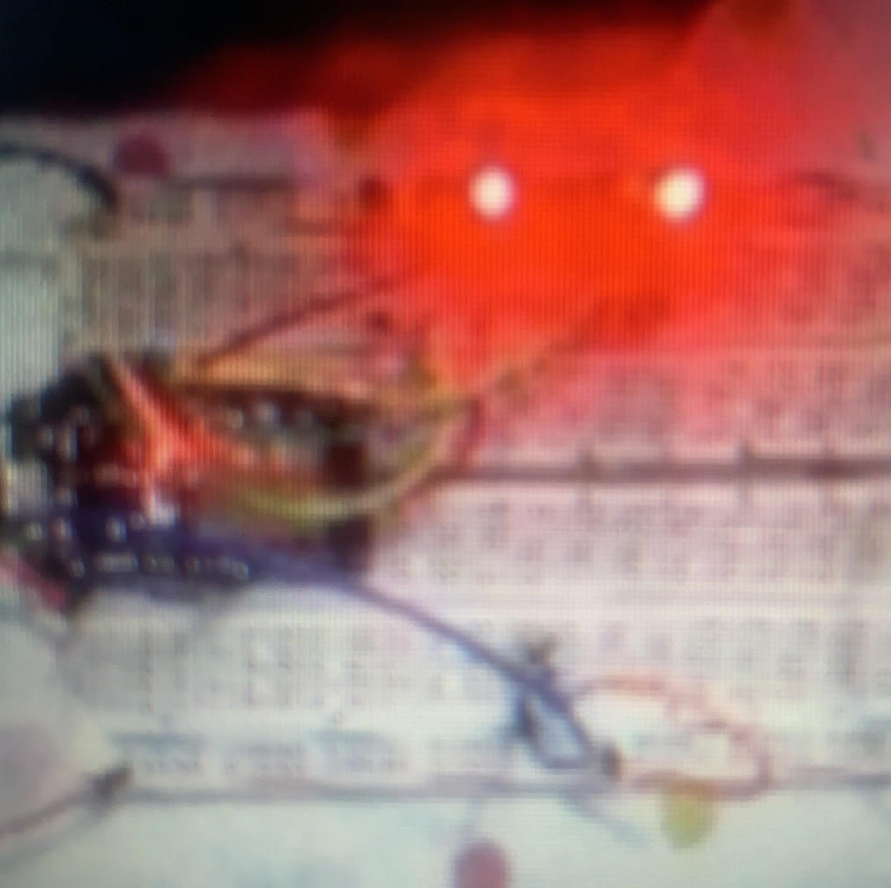
Picture of circuit with working LEDs
ESP 32 Board
Colored LEDs: Red, Yellow and Green (two sets)
220 Ohm Resistors (optional)
Push Button
Wires
Breadboard

Slide 15
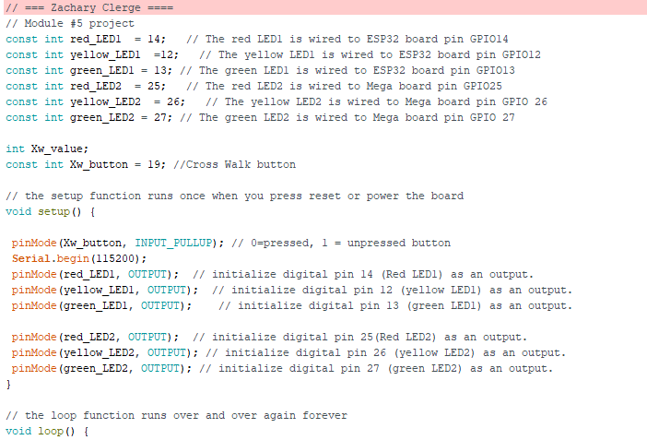
Screenshot of code in Arduino IDE
Screenshot of code in Arduino IDE showing your name in the comment

Slide 16
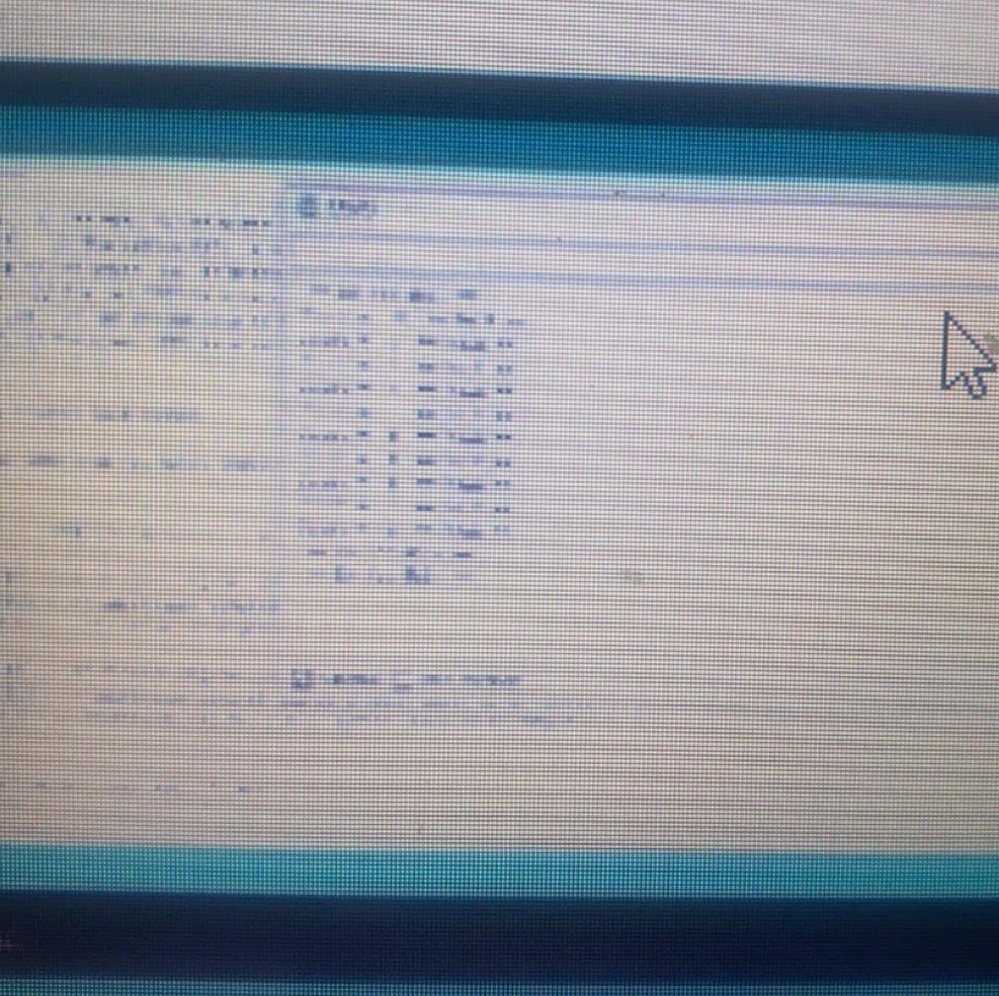
Screenshot of Serial Monitor in Arduino IDE
Screenshot of output in Serial Monitor

Slide 17
CEIS 114
Module 6
Creating a Multiple Traffic Light Controller with a Cross Walk and an Emergency Buzzer
Zachary Clerge

Slide 18
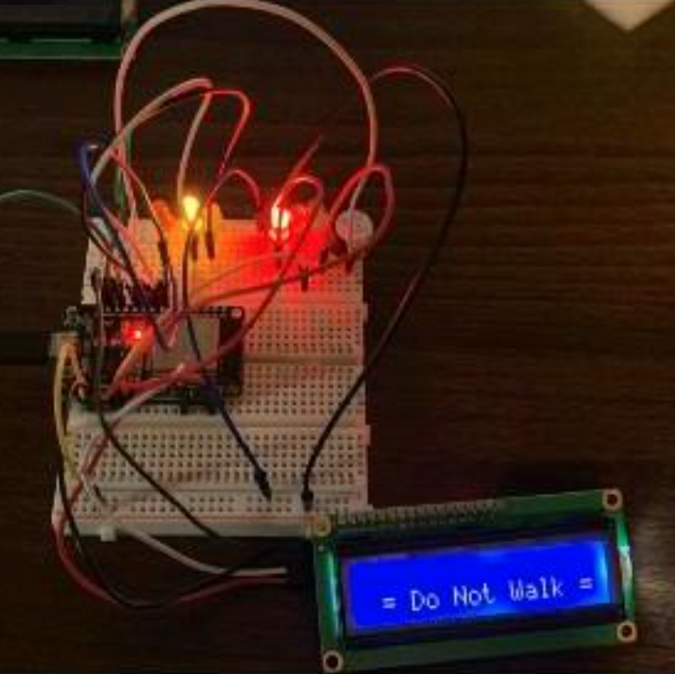
Picture of circuit with working LEDs and LCD display
ESP 32 Board
Colored LEDs: Red, Yellow and Green (two sets)
220 Ohm Resistors (optional)
Push Button
LCD Unit with Message Display
Wires
Breadboard

Slide 19
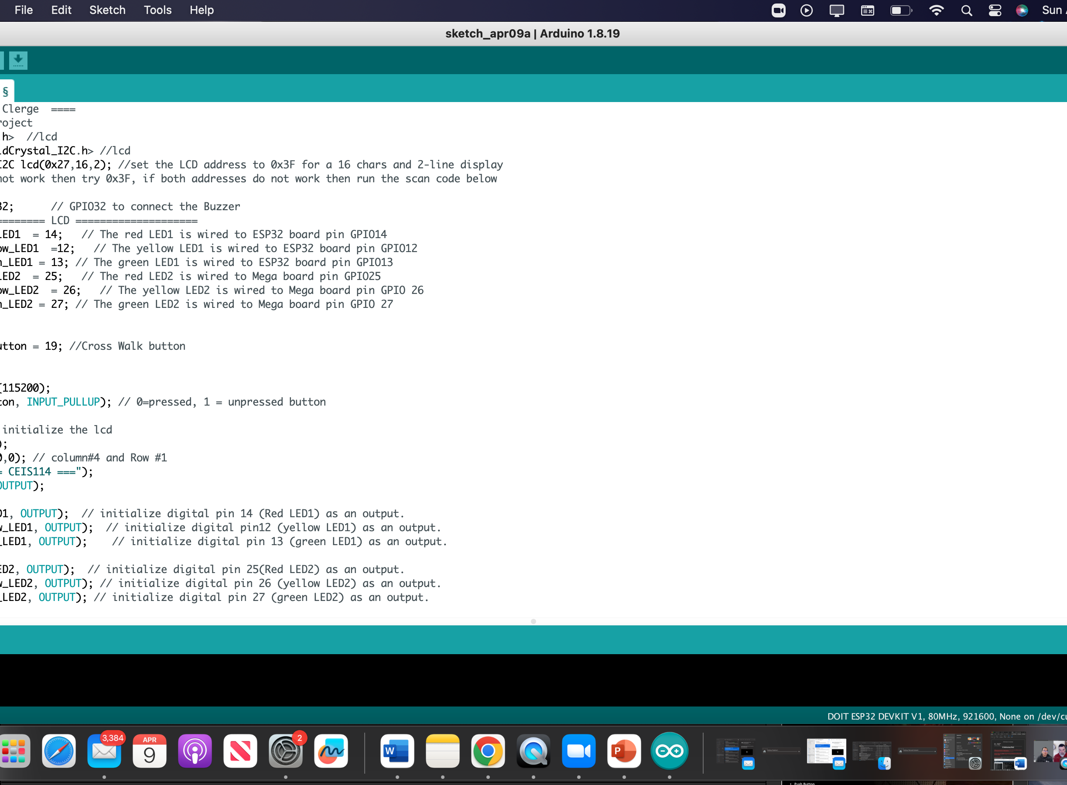
Screenshot of code in Arduino IDE
Screenshot of code in Arduino IDE showing your name in the comment

Slide 20
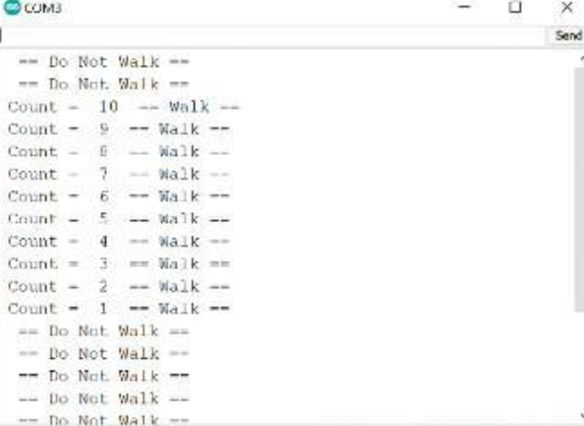
Screenshot of Serial Monitor in Arduino IDE
Screenshot of output in Serial Monitor

Slide 21
Module 7
CREATING A MULTIPLE TRAFFIC LIGHT CONTROLLER WITH A CROSS WALK AND AN EMERGENCY BUZZER WITH SMART SENSOR

Slide 22

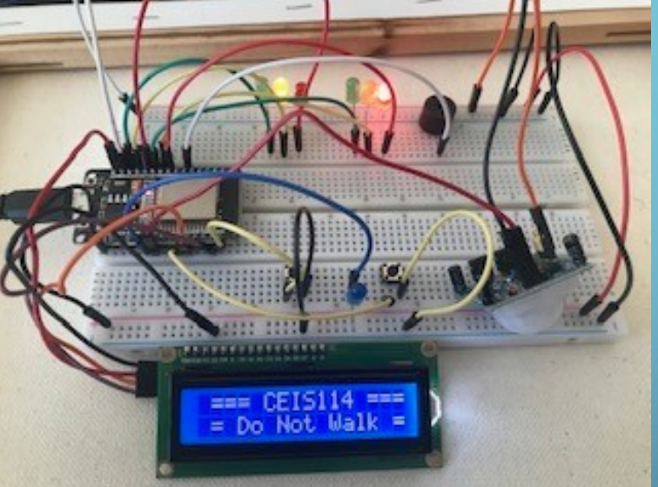
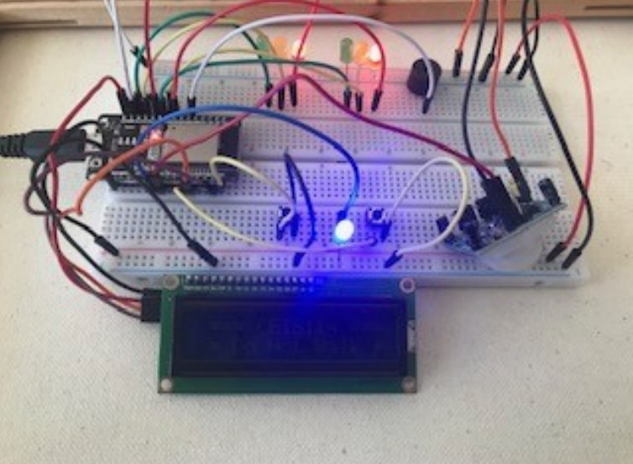
PICTURE OF CIRCUIT WITH WORKING LEDS AND LCD DISPLAY Designed a traffic light that was continuously active in one direction of the major street and an always red traffic light on the minor street with less traffic. Integrated a motion detector that will activate the minor street traffic light when there is motion (cars) detected. Added a push button to activate the cross walk. Added a push button to activate the Emergency

Slide 23
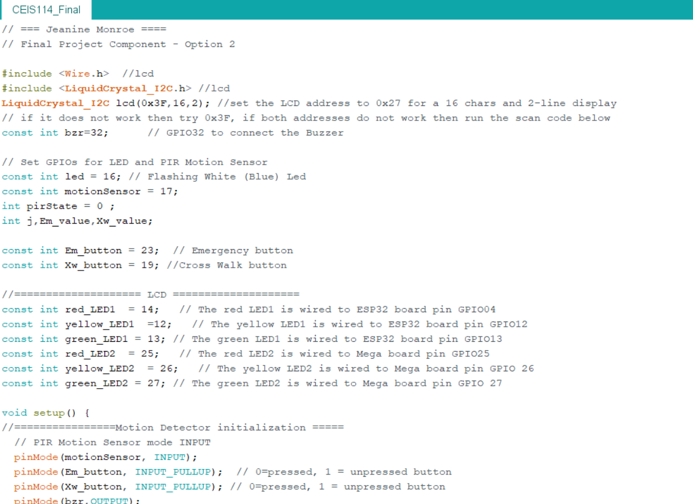
Screen shot of Code in Arduino

Slide 24
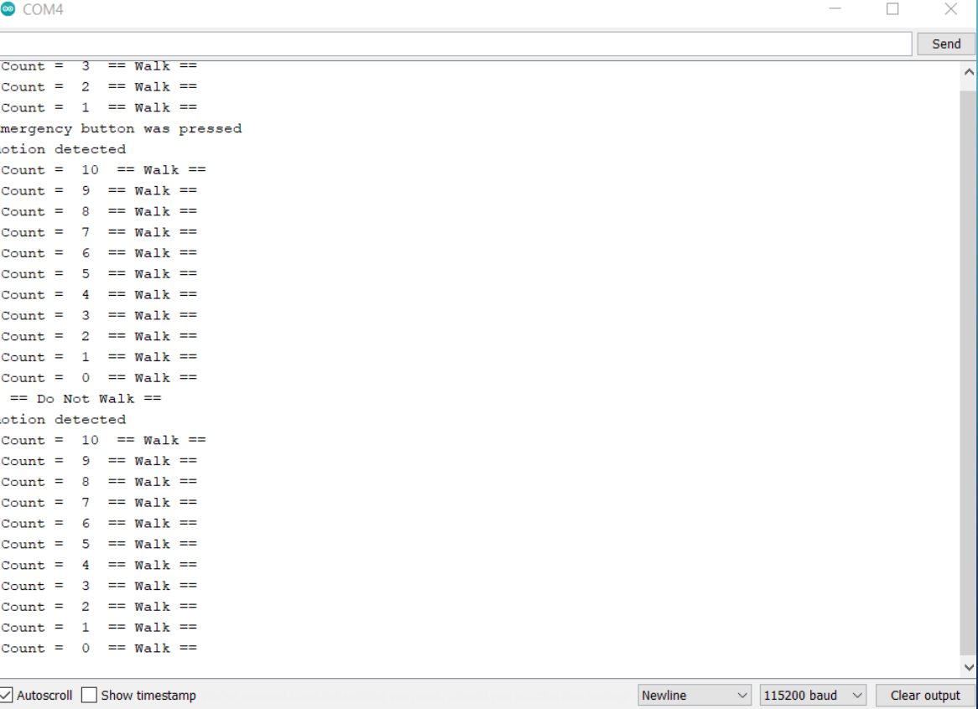
Serial Monitor output

Slide 25
CHALLENGES
BAD WIRES INCLUDED IN THE INTERNET OF THINGS TECH CORE KIT
Using MACOS originally led to some great difficulties with using Arduino
Running the code

Slide 26
Skills Learned
Configuring Hardware
Programming
Devops
TROUBLESHOOTING
Code
Electrical
Networking

Slide 27
CONCLUSION
Even though I ran into a lot of different problems with this project , it really made m realize the process of troubleshooting to another level , it was all nothing I couldn’t handle our research to overcome, I believe I will use all the skill I obtained in the near future and am a better future engineer because of it.

