Slide 1

Final Project
Fundamentals of Infrastructure Security
Zachary Clerge

Slide 2
Intrusion Analysis using Wireshark

Slide 3
Basic attack analysis
Look at captures no. 20 and 22. (You can use the “Go” link at the top of the Wireshark screen to quickly go to a specific capture) Both packets are ICMP traffic but there are subtle differences between them. Compare the time-to-live and data field sizes in the two packets. What differences do you see?
Not many diffrenve both ping request with same 64 time to live on difference I see is in the checksum
Do a little Internet research to discover which operating systems use the specific values in their ping commands. What operating system generated the echo request in capture 20?
From packet 20 it is coming from a Microsoft operating system (Windows)
Review packet no. 37 and beyond, what do you think is taking place here? _______Validation of the Ping Request between systems ___________
Look at capture 22846. What is suspicious about the flag settings in this packet? N/A
What is the IP address of the host being targeted? 192.168.177.255

Slide 4
Course Project
Fundamentals of Infrastructure Security
Module 3 Open SSL

Slide 5
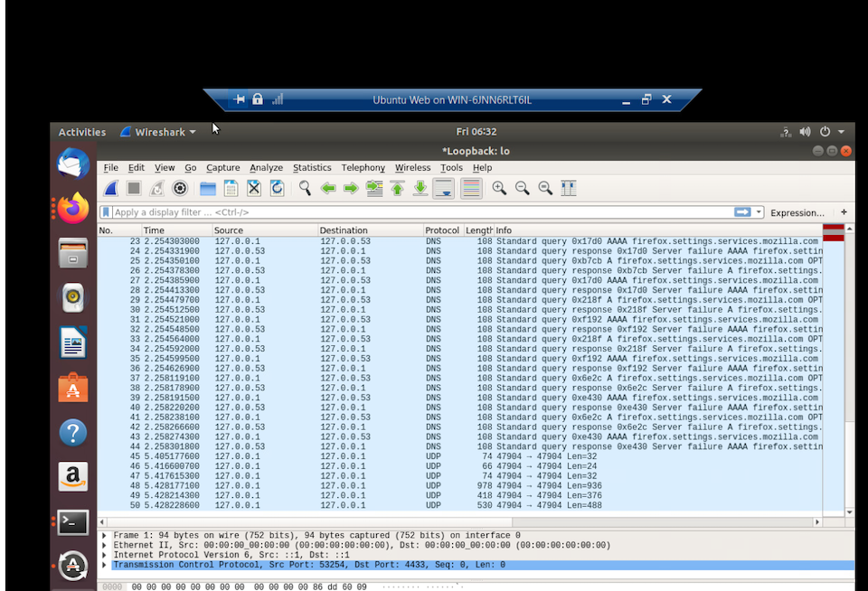
Creating and testing an SSL/TLS file
Take a screenshot of the output in Step 20.
It should show the GET request in the Info column.

Slide 6
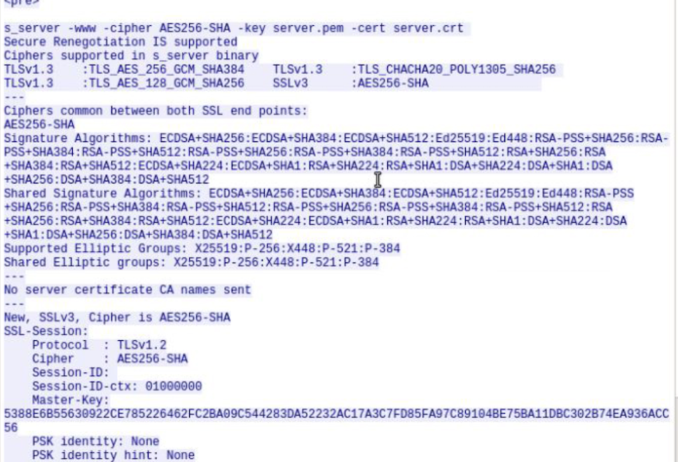
Creating and testing an SSL/TLS file cont’d
Take a screenshot of the output in Step 22.
It should show the decrypted SSL stream.

Slide 7
Snort

Slide 8
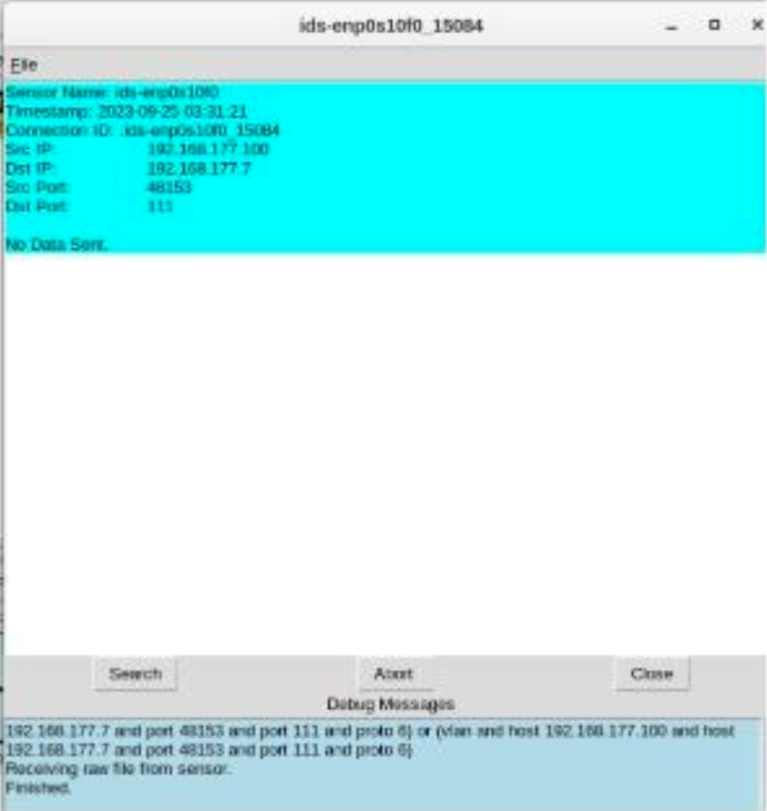
Testing Snort rules
Take a screenshot of the output in Part 1 Step 17.
It should show the transcript of the XMAS scan alert.

Slide 9
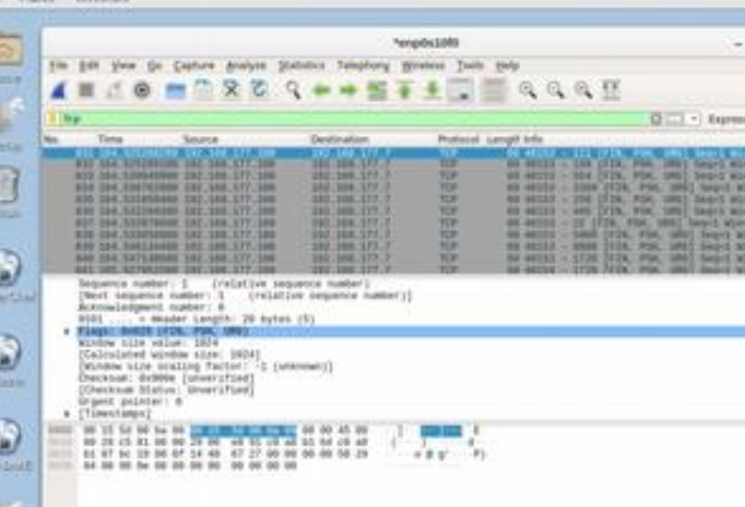
Testing Snort rules cont’d
Take a screenshot of the output in Part 1 Step 20.
It should show the TCP packets generated by the XMAS scan.

Slide 10
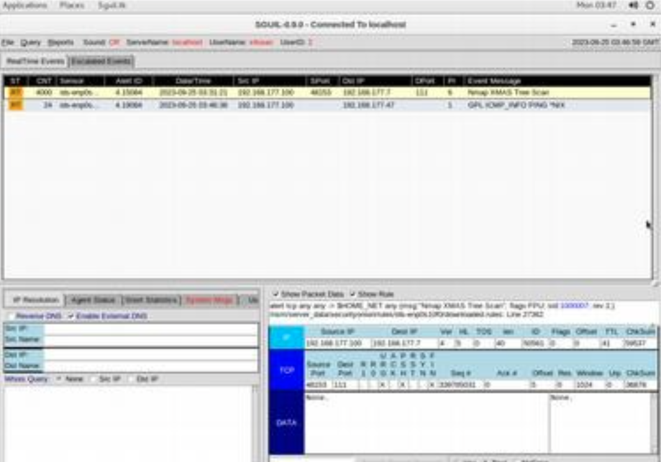
Creating Snort rules
Take a screenshot of the output in Part 2 Step 7.
It should show the ping activity alert.

Slide 11
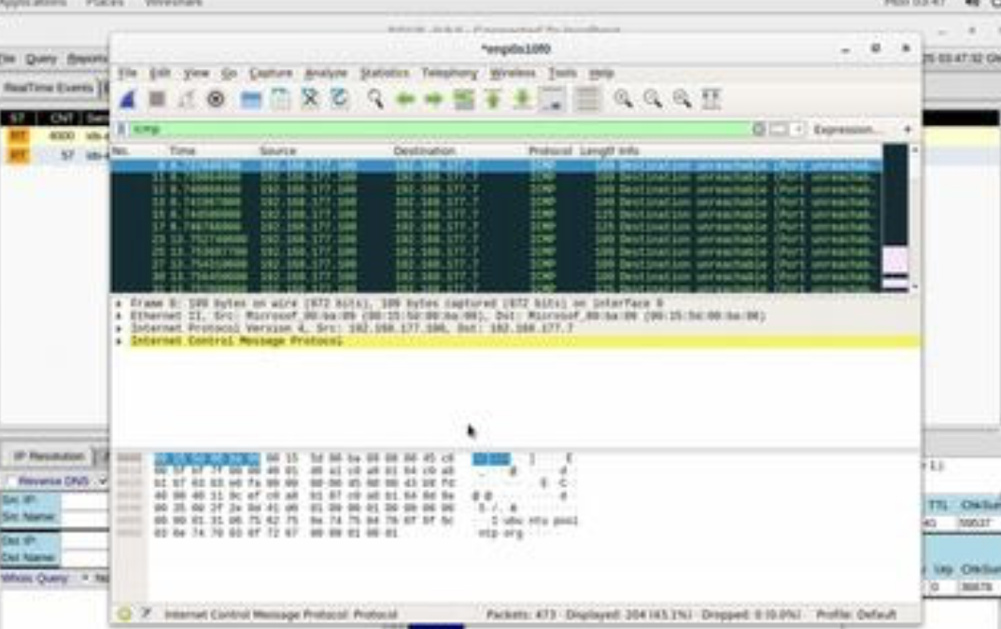
Creating Snort rules cont’d
Take a screenshot of the output in Part 2 Step 8.
It should show the ICMP packets generated by the ping activity.

Slide 12
Live Memory Analysis

Slide 13
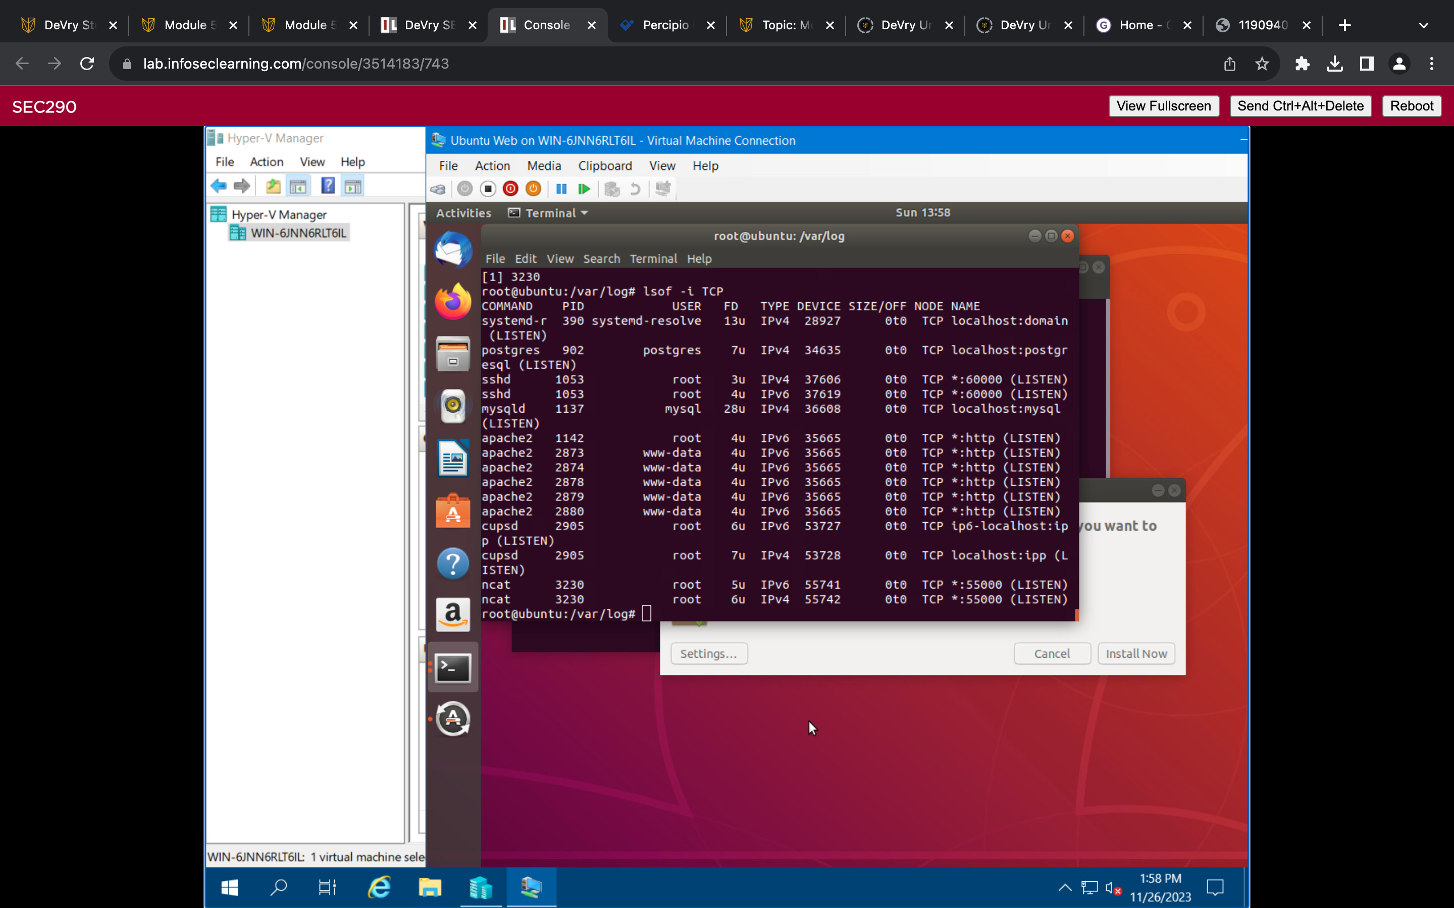
Linux Processes
Take a screenshot of the output in Part 1, Step 16.
It should show port 55000 open for both IPv4 and IPv6.

Slide 14
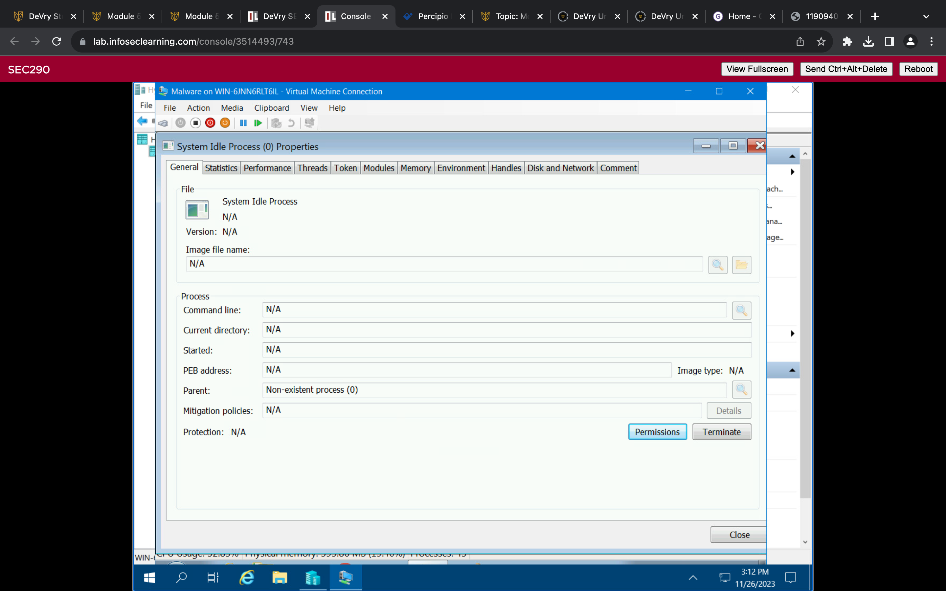
Process Hacker
Take a screenshot of the output in Part 2, Step 5.
It should show properties of a chosen process.

Slide 15
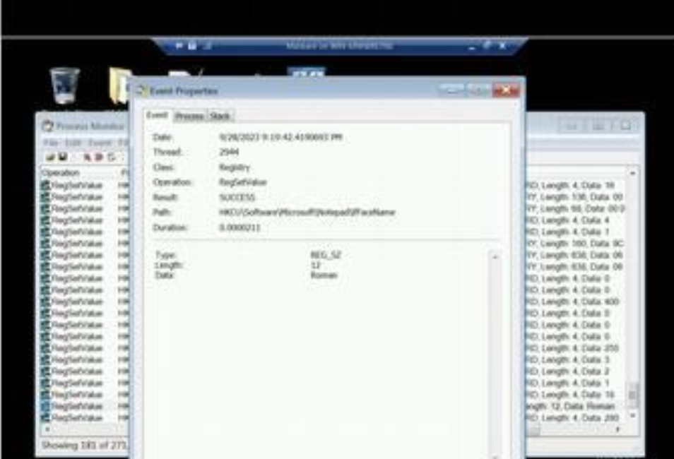
Process Monitor
Take a screenshot of the output in Part 3, Step 13.
It should show ifFaceName in the Path column and Data: Roman in the Detail column.

Slide 16
References
Cyber Daily Podcast
Volatility 101 ep128
2. McKay, D. (2019, June 26).
. How to Use the Linux lsof Command.
https://www.howtogeek.com/426031/how-to-use-the-linux-lsof-command/

Slide 17

Firewall

Slide 18
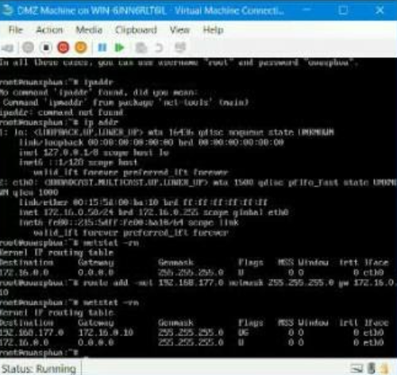
Time-based Access
Take a screenshot of the output in Part 1 Step 21.
It should show the output of the DMZ Route Table.

Slide 19
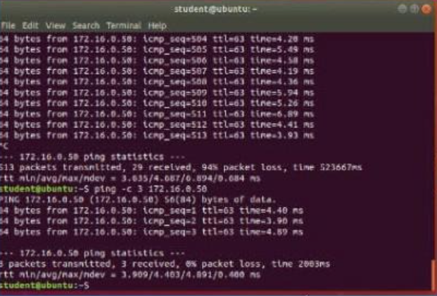
Time-based Access
Take a screenshot of the output in Part 1 Step 26.
It should show a successful ping from the Ubuntu Web VM and the DMZ VM.

Slide 20
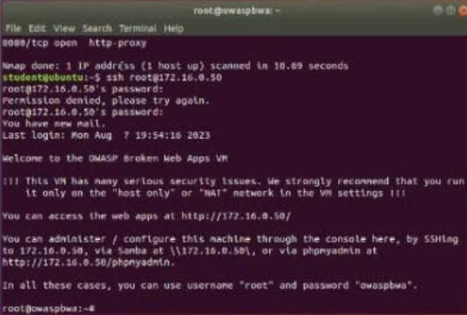
Time-based Access
Take a screenshot of the output in Part 1 Step 34.
It should show two time-based access rules in the FORWARD chain

Slide 21
Lessons Learned
Learned proper Traffic analysis Concepts using WireShark
Gained knowledge on using Snort and its roles inside of a SIEM
Gained good hands-on knowledge using Linux in Security environment

Slide 22
Career skills
Taught core concepts of CYSA+ which is the gold standard for analyst
IT expanded my knowledge on Wireshark and other packet sniffing tools
Introduced me possibility of reverse engineering .
I truly believe this class prepared me to be a better analyst for the reason provided

