Slide 1

Python Object-Oriented GUI Application
Zachary Clerge
2/21/24

Slide 2
INTRODUCTION
Python is the number 1 used scripting language in the world
We Developed a console stock track Application
We updated the Application With a GUI FrontEnd
This entire process I used Object-Oriented Principles

Slide 3
Module 2 Objectives
Create a Class Diagram
Create A Class Using Python Syntax
Apply Unit Testing To the Python Class Code

Slide 4
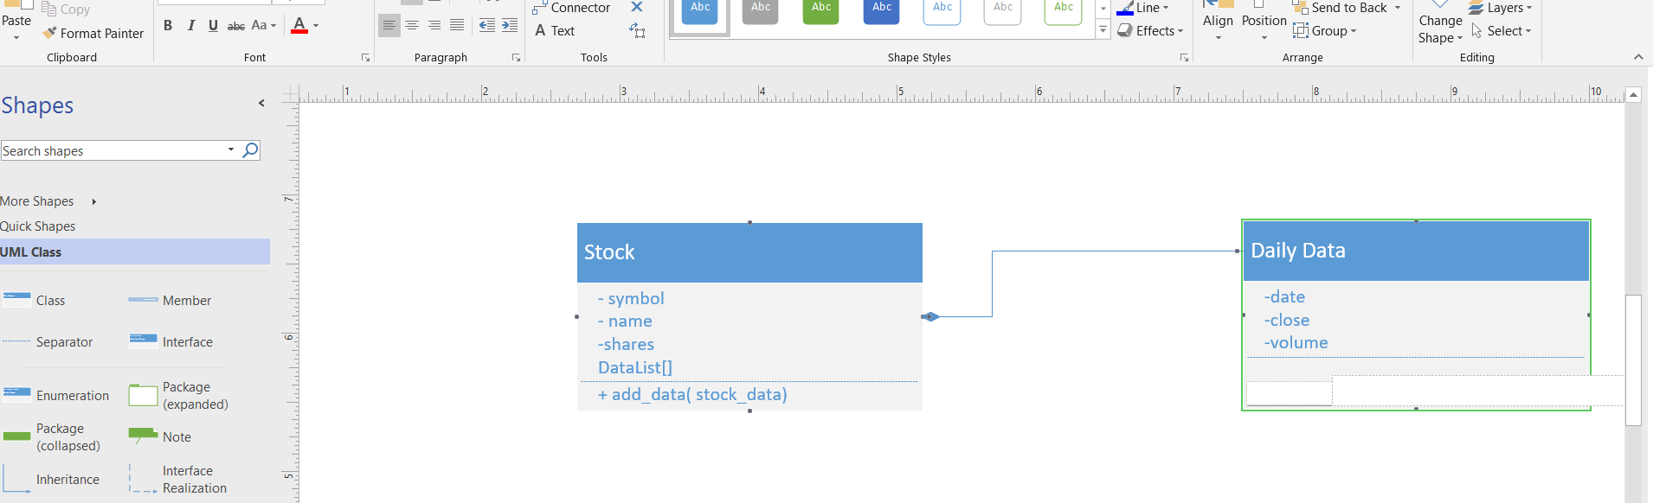
Class Diagram
Paste your Visio Class Diagram

Slide 5
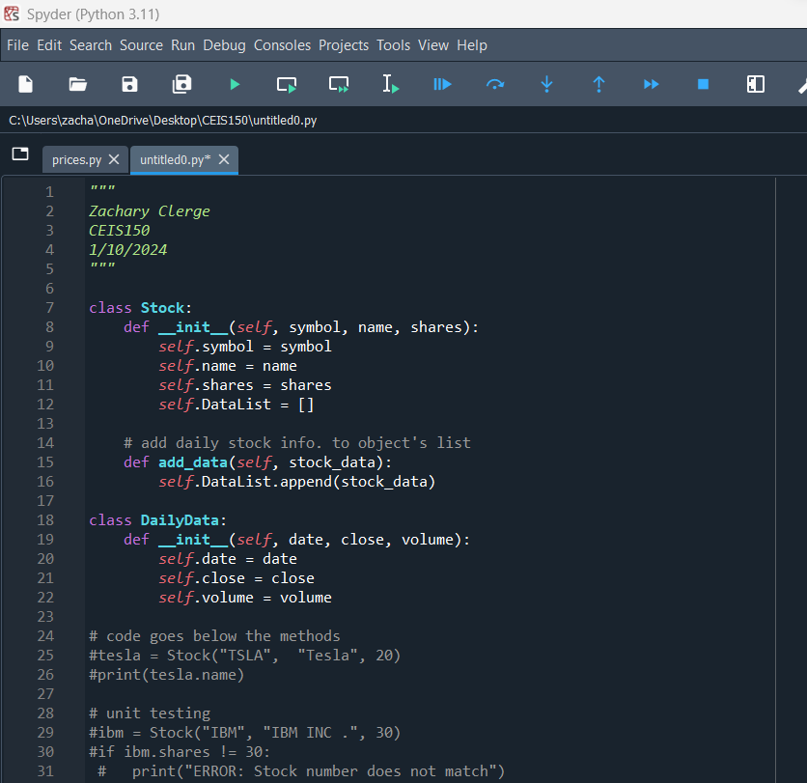
Class Code
Screen Shot of your stock_class.py file.

Slide 6
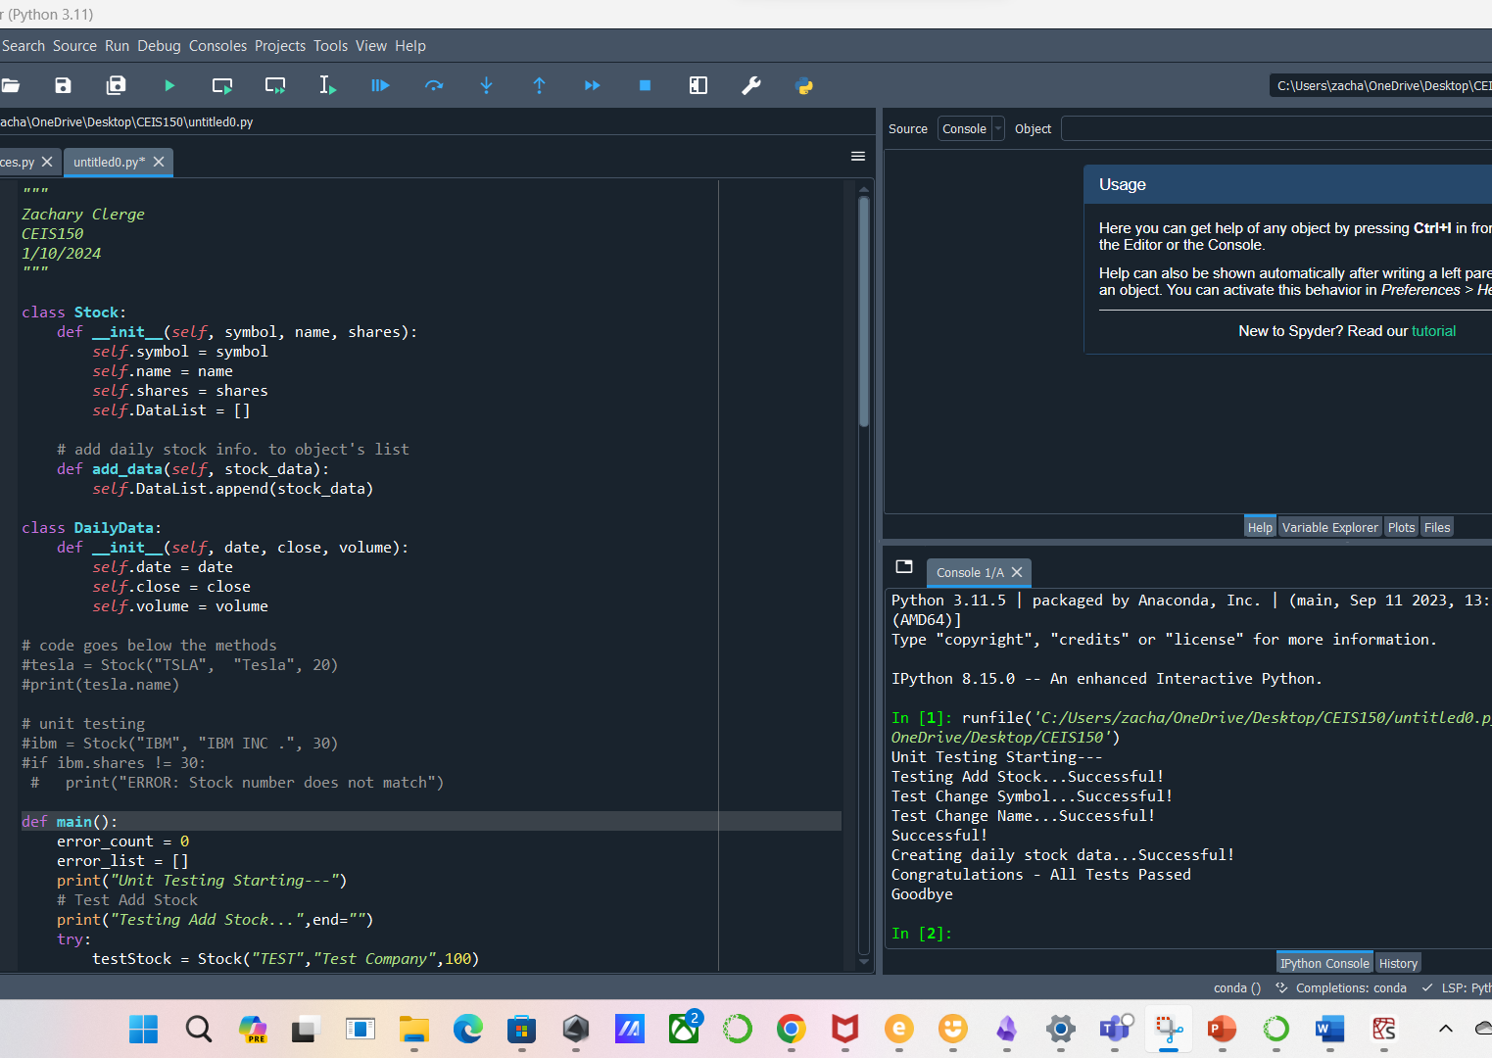
Unit Test
Screen Shot of your successful unit test.

Slide 7
Module 3 Objectives
Adding Stock as Part of Application Data
Listing ALL Stocks With Professional Console Output
Adding Daily OutPut

Slide 8
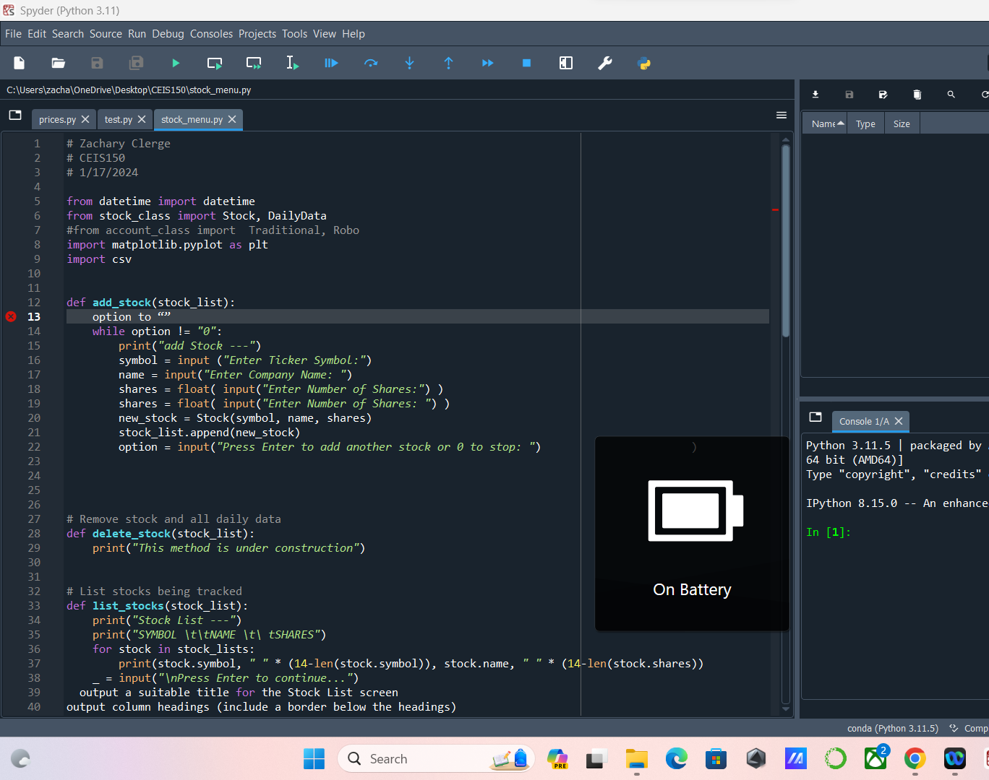
Adding a Stock
Paste a screen shot of your working Stock program.

Slide 9
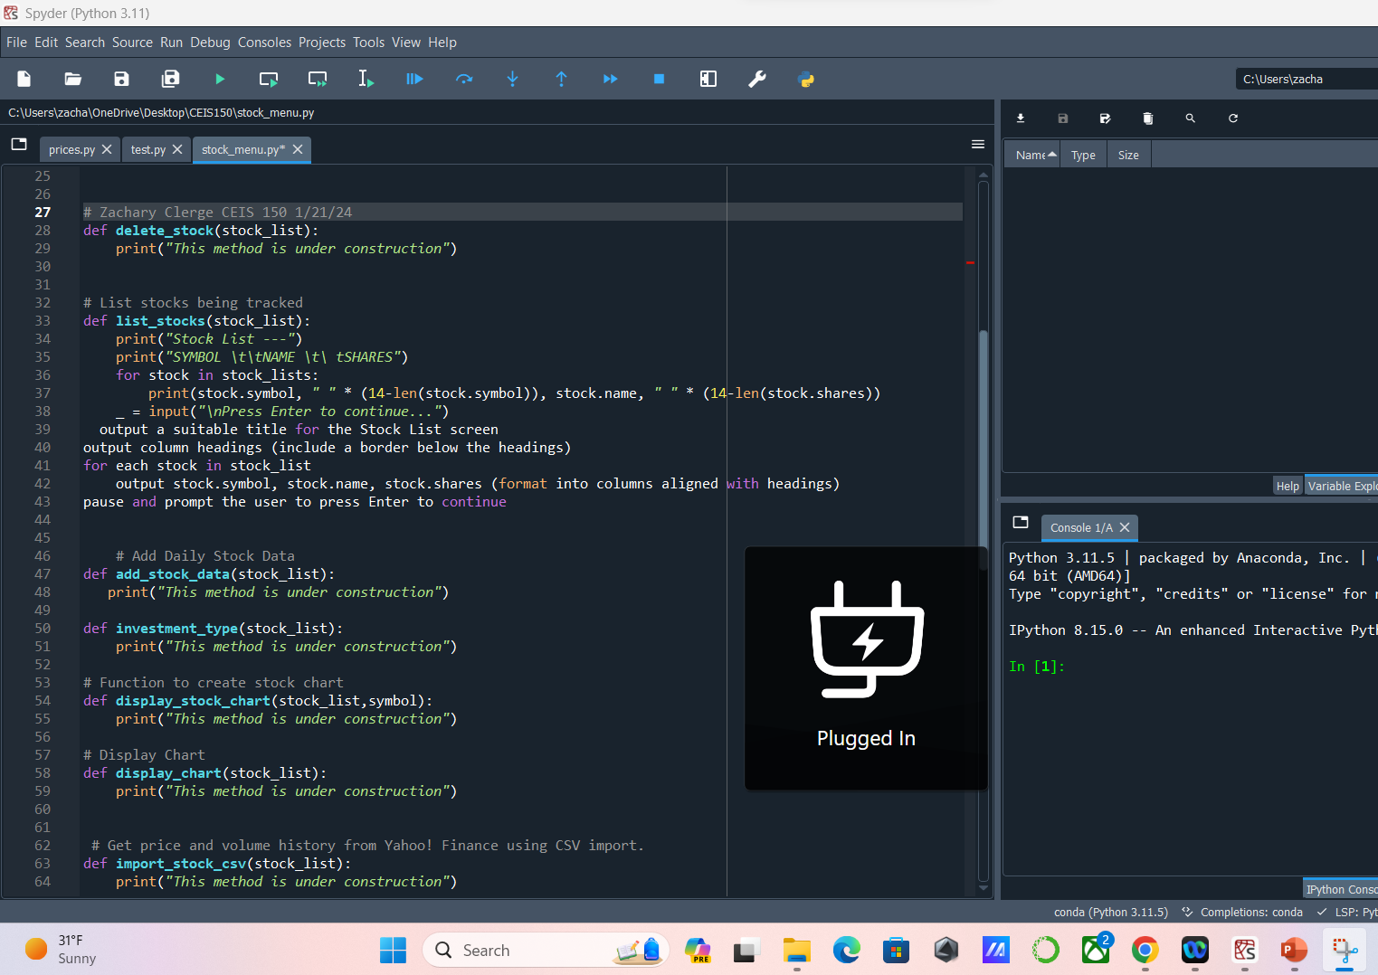
Listing 3 Stocks
Paste a screen shot of your working Stock program.

Slide 10
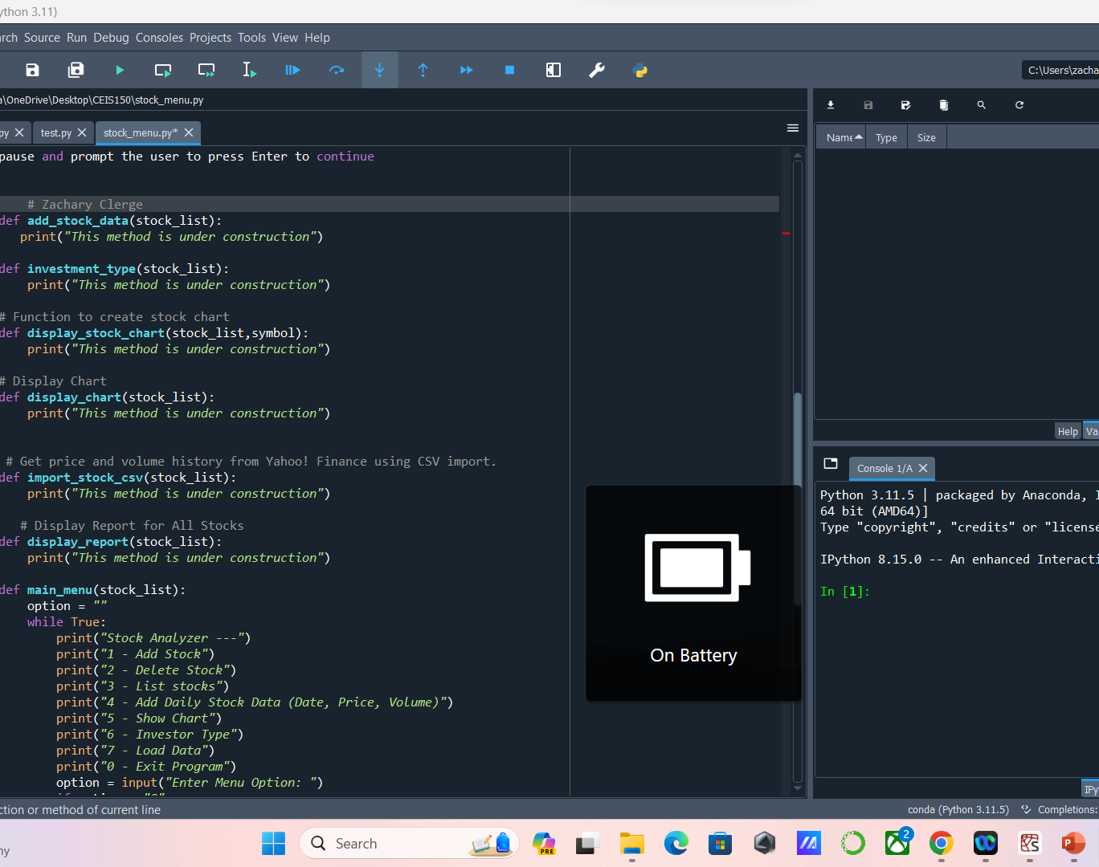
Daily Data
Paste a screen shot of your working Stock program.

Slide 11
Module 4 Objectives
Inherited Cases
Tested Units
Went further with final developments of main Code

Slide 12
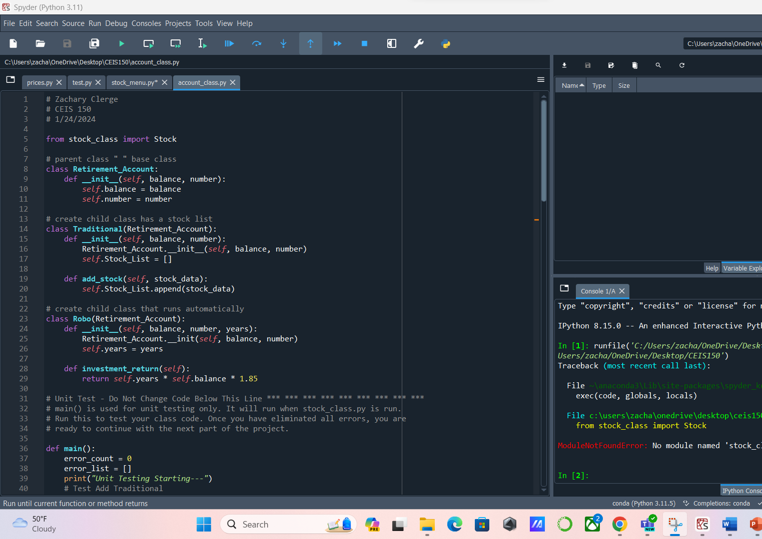
Inherited classes
Paste a screen shot of your classes

Slide 13
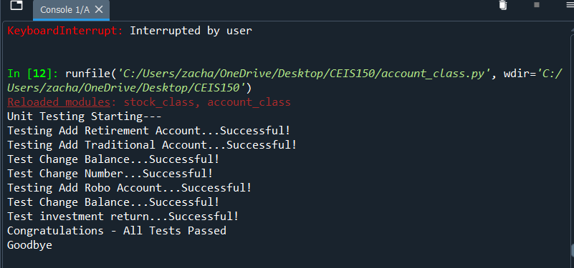
Unit Tests
Paste a screen shot of your unit tests successfully completed

Slide 14
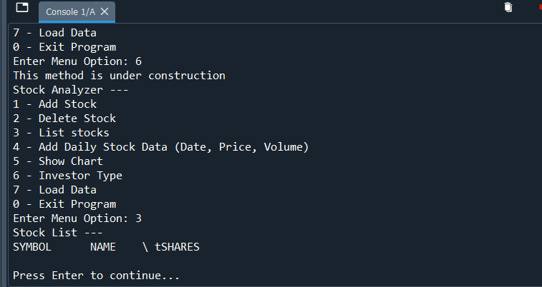
Stock menu program
Paste a screen shot of your classes in the main program

Slide 15
Module 5 Objectives
Set a Working Chart

Slide 16
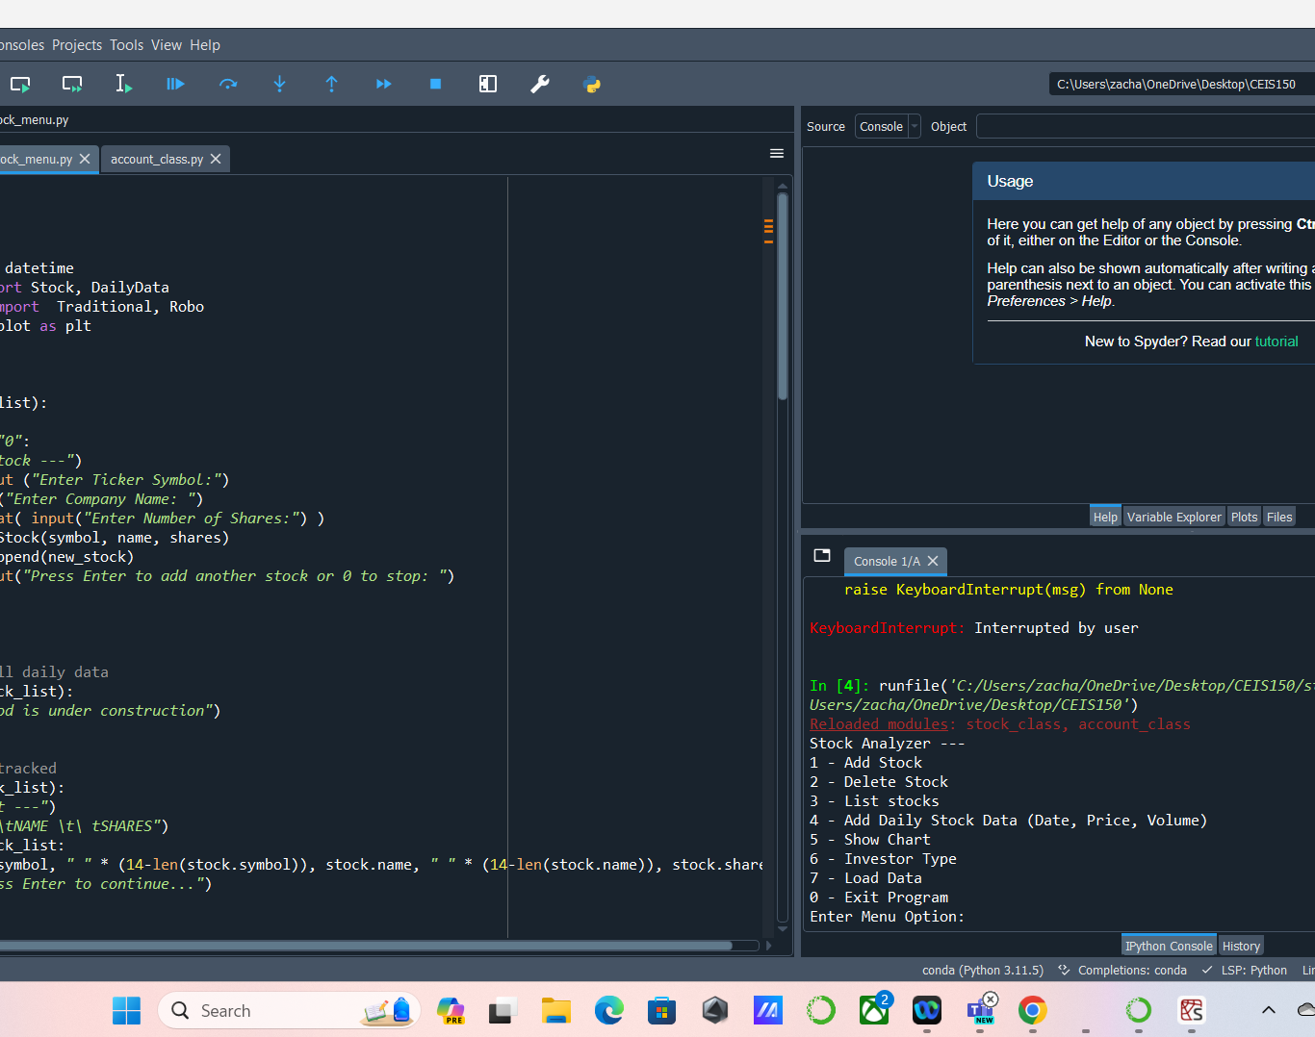
Chart
Paste a screen shot of your stock chart.

Slide 17
Module 6 Objectives
Sourced data from File explorer
Imported Functional historical CSV Data

Slide 18
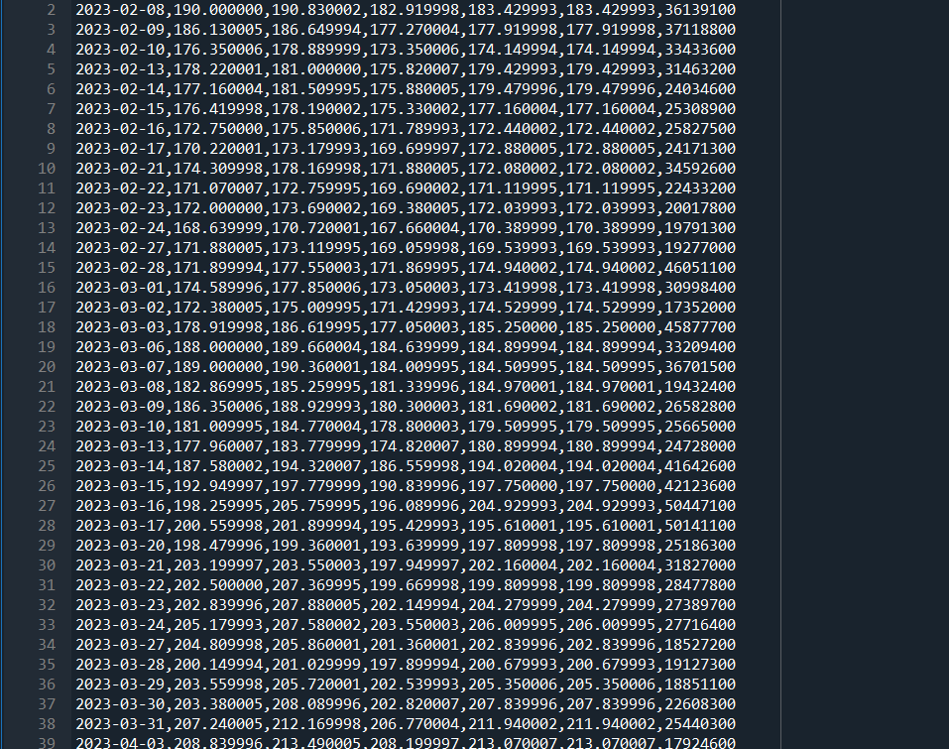
File
Paste a screen shot of the file downloaded from Yahoo finance

Slide 19
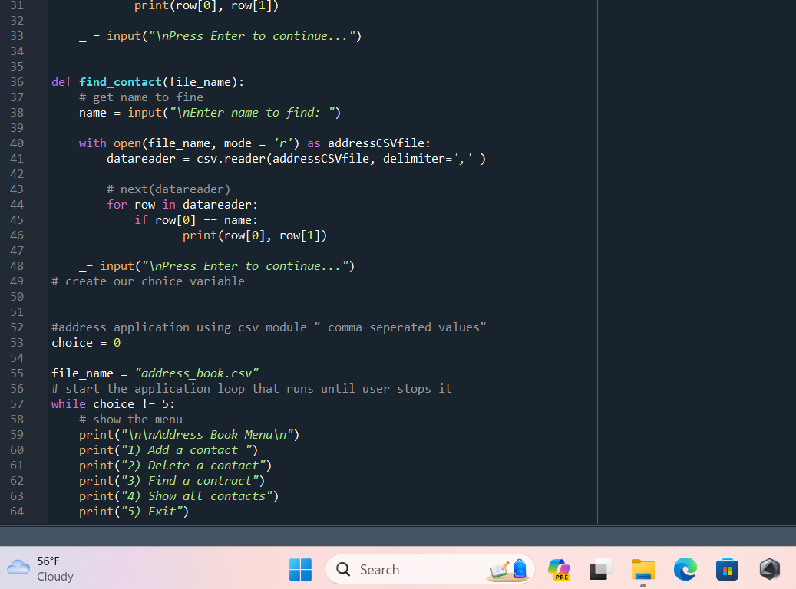
Importing data
Screenshot of the historical data import

Slide 20
Module 7 Objective
Created Stock GUI using Vision Studio
Functional history Tab
Final Report Complete

Slide 21
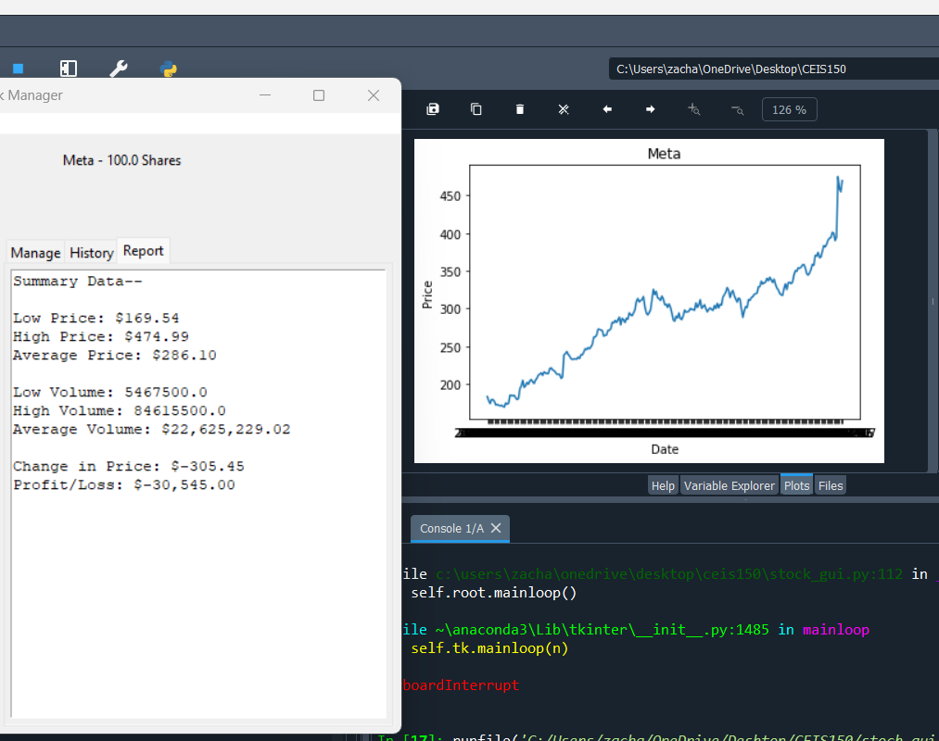
Stocks in GUI
Paste a screen shot of your GUI working

Slide 22
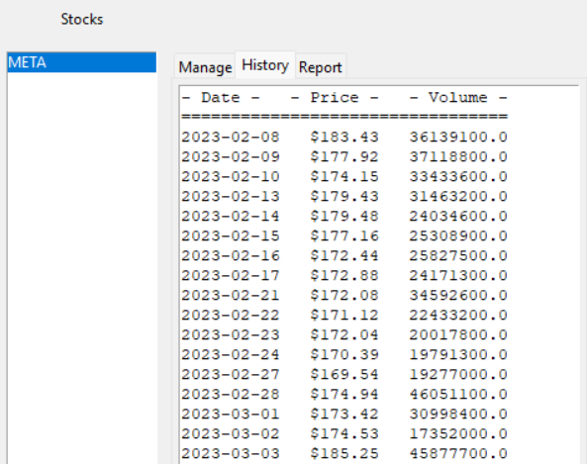
History Tab
Paste a screen shot of your History tab with import working.

Slide 23
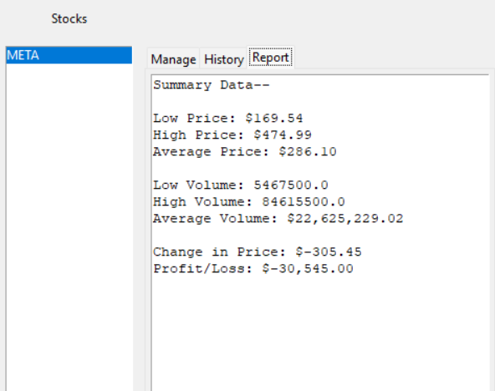
Report Complete
Paste a screen shot of your Report tab

Slide 24
Career Skills
Gained a Deeper understanding of Python Programming Language , Getting hands on with Object-Oriented Systems

Slide 25
Conclusion
Python Once you get the hang of Tabs in indentation is a Fun and Powerful Language
Python is the Most Used Language used in many Industries Ranging From Programming , Aerospace, All the way To Cyber Security and Networking .

