Slide 1


SEC285 Final Project
Zachary Clerge

Slide 2
Asymmetric Key Encryption

Slide 3
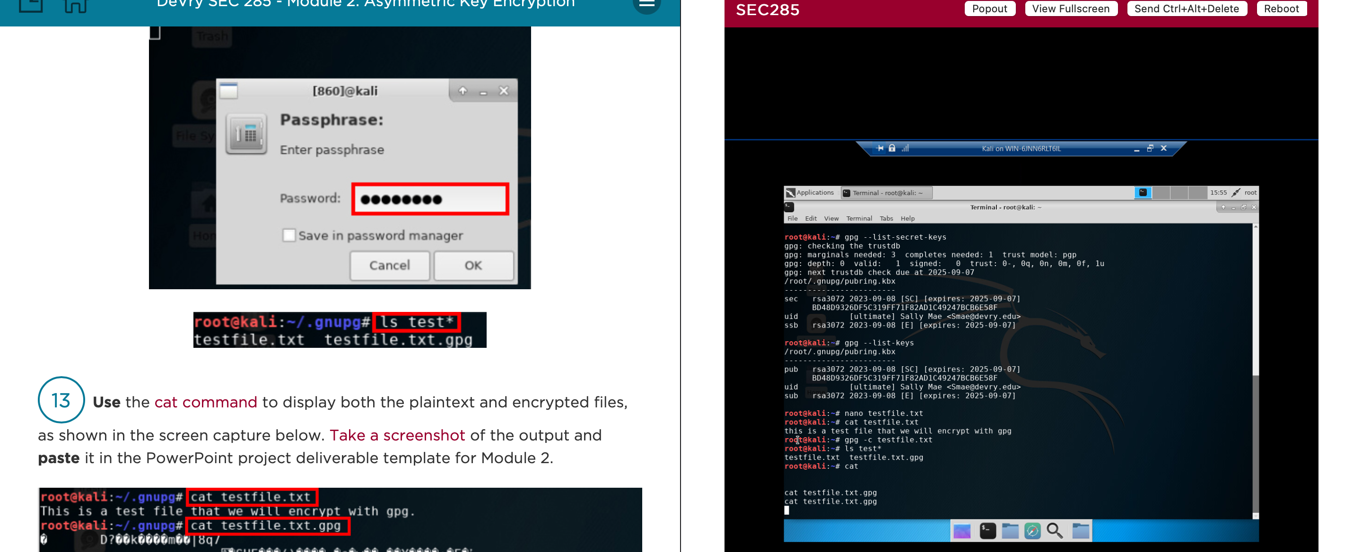
File Encryption
This screenshot should show the following.
Content of the plaintext file
Content of the encrypted file

Slide 4
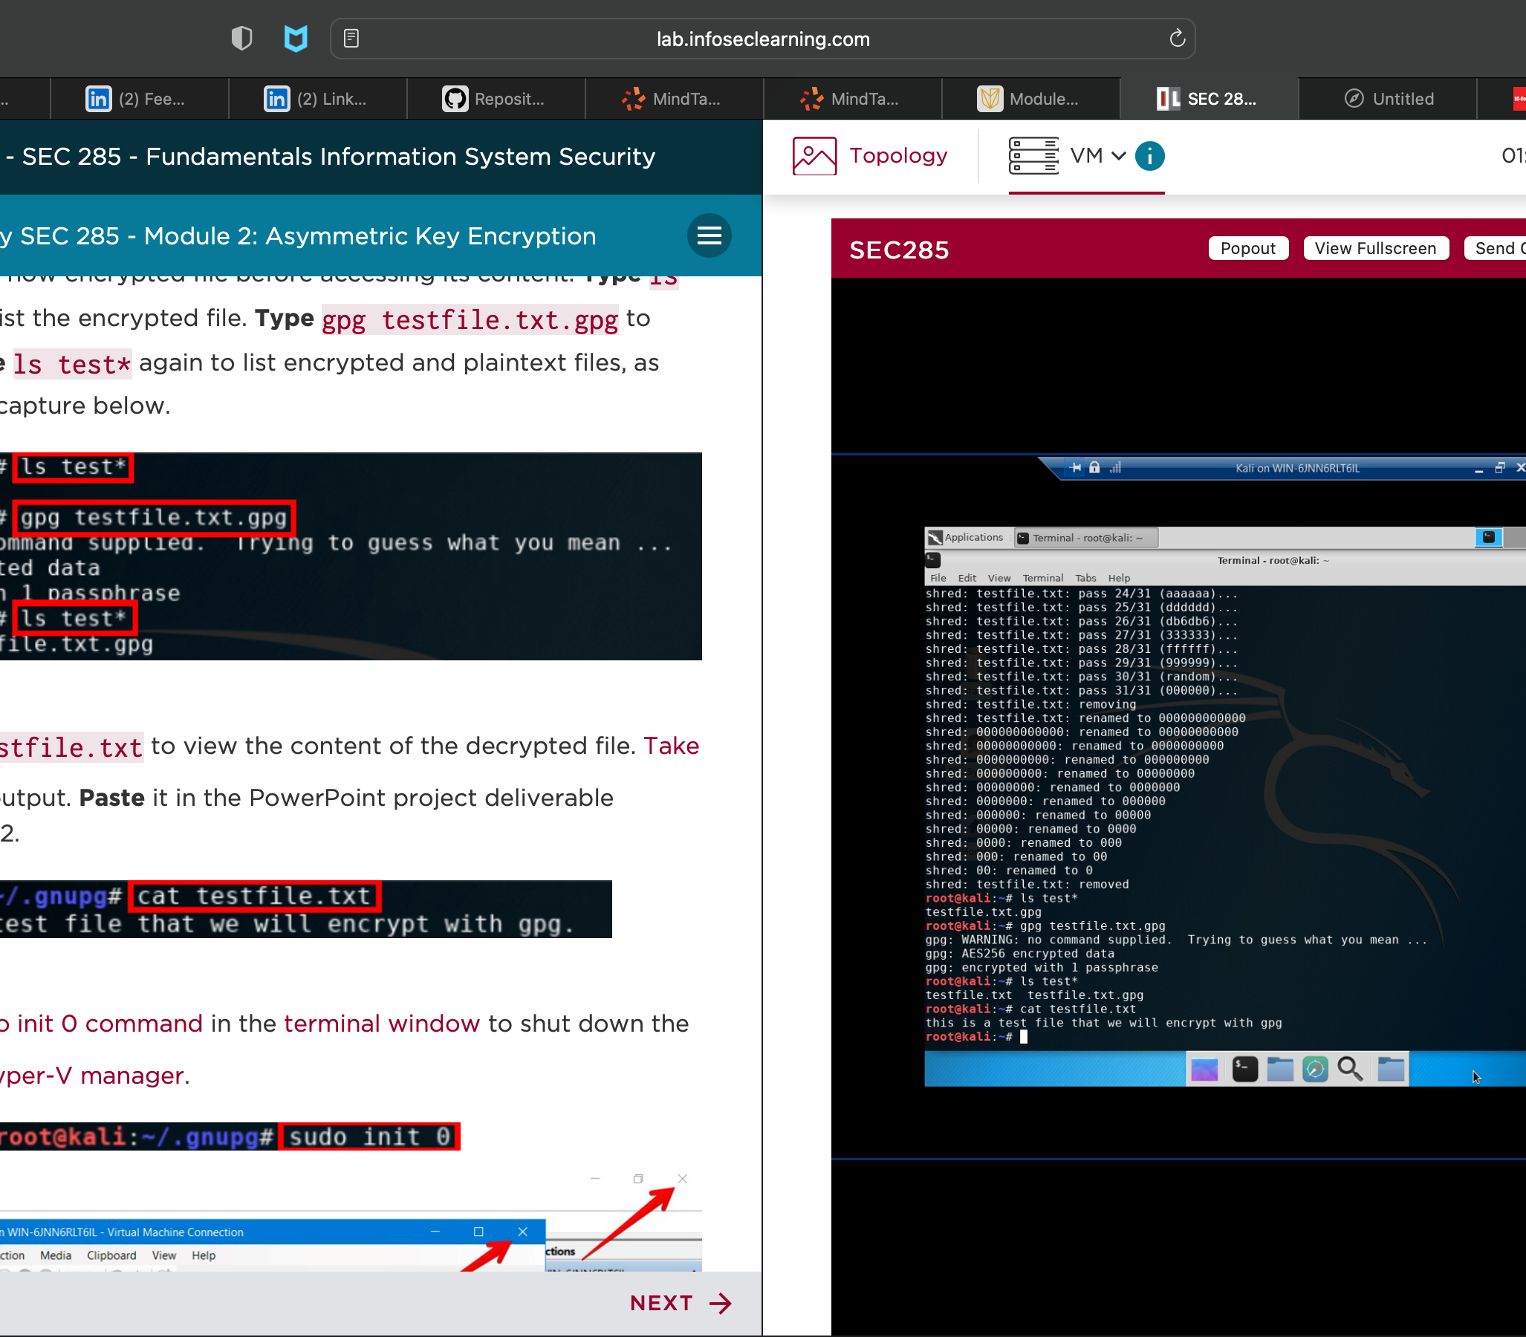
File Decryption
This screenshot should show the following.
The encrypted file being listed by itself
The decrypting process
Both the encrypted file and the original plaintext file being listed

Slide 5

Stateful Firewall

Slide 6
Question
What effect does the sudo iptables --policy INPUT DROP command have on the access to computing resources?
Answer here: from what I can see it seemed that this command was blocking the web traffic that was attempting to come into the system
References: Comptia Studies Via ”mike myers comptia SEC+ review

Slide 7

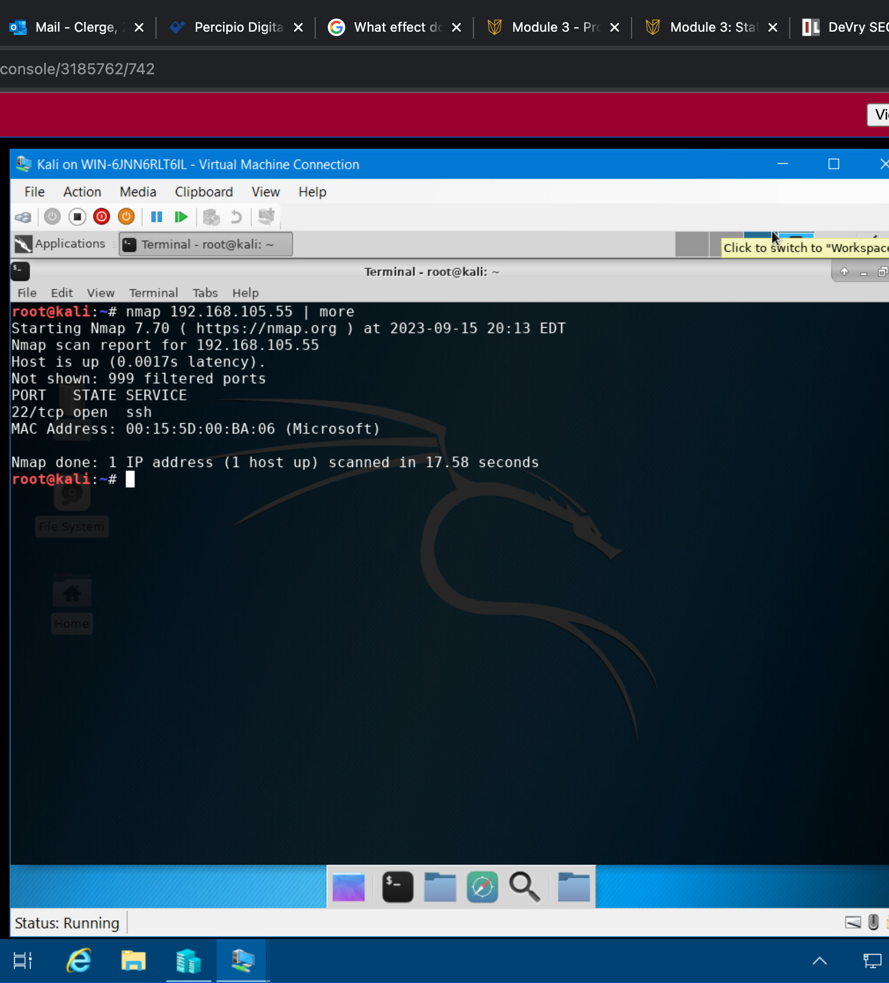
Nmap Scan
This screenshot should show the Nmap scan result of the Linux Server VM.

Slide 8
Bring Your Own Device (BYOD)
Security Policy

Slide 9
Overview:
Smart phones , tablets, and laptops are all devices used to get much work done around modern companies. This isn’t limited to research, osnit,and communication given the security landscape of today these are all target surfaces for an organization where companies files could be leaked if not handled properly
2. Purpose:
[Please remove after completion: The main goal of any IT security policy is to protect confidentiality, integrity, and availability (CIA) of data. With that said, one reason to have the BYOD security policy is to identify devices that introduce unnecessary vulnerabilities to the organization's computing resources. Address how timely discovery of such vulnerabilities will reduce the attack vector on an organization's computing resources.]
In the event of suspected compromise of any if these devices it is impartive that communication with the incident response and SOC team is done immeditealy the faster the communication the less likely this threat could spread or compromise the company further .

Slide 10
3. Scope:
tablets, phones,and laptops are all used in modern enterprise this is something known as long as the devices are approved prior to usage. And if devices are going to be used out of the enterprise in personal environments using personal wifi a VPN should be inplace one that encrypts all the company's information being accessed .
4. Policy:
BYOD should always have an authorization in place, they should also have all approved software and network updates and should not have no unapproved application on them at any time.

Slide 11
5. Policy Compliance:
The InfoSec team will verify compliance to this policy through various methods, including but not limited to, periodic walk-through, video monitoring, intrusion detection tools, business tool reports, internal and external audits, and feedback to the policy owner.
An employee found to have violated this policy may be subject to disciplinary actions up to and including termination of employment.
6. Related Standards, Policies, and Processes:
[Please remove after completion: What other documents, such as HIPAA or PCI-DSS standards, can be linked to this policy and why? ]
If the company is involved in healthcare, then hipaa will apply which is keeping all patient data hiding and undisclosed while if they are in the banking world PCI-DSS would then apply

Slide 12
7. Definitions and Terms:
BYOD- bring your own device
MDM- mobile device management
VPN-virtual private network
8. Revision History:
Date of change | Responsible | Summary of change
September 2023 | SANS policy team | Updated and converted to new format

Slide 13

Vulnerability Assessment

Slide 14
Rubric
Activity | Requirement(s) | Points
Nmap | Screenshot | 15
NetCat | Screenshot | 15
Wireshark | Screenshot | 15
Nessus | Screenshot | 15

Slide 15
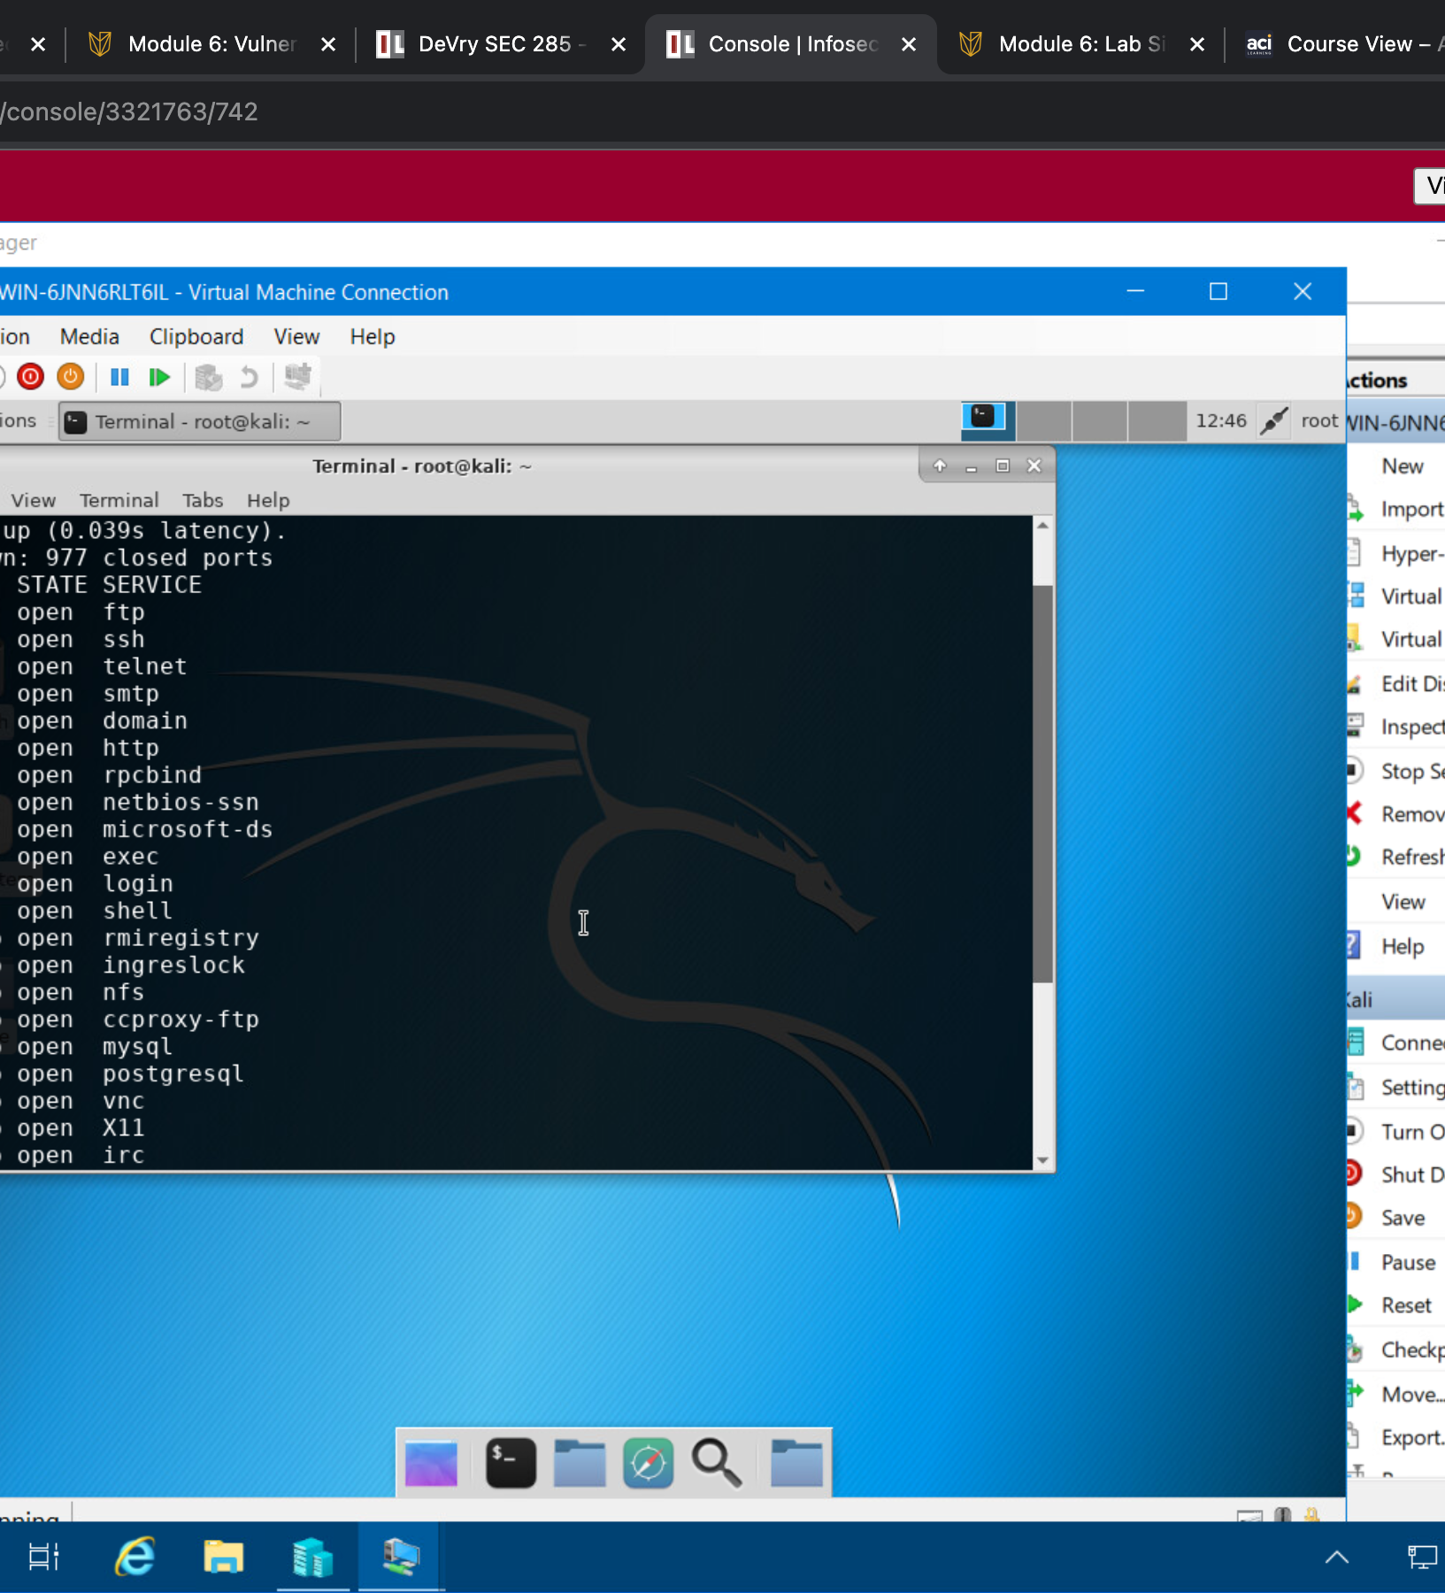
Nmap
This screenshot should include the scan result showing both the Kali and Linux Server VMs.

Slide 16
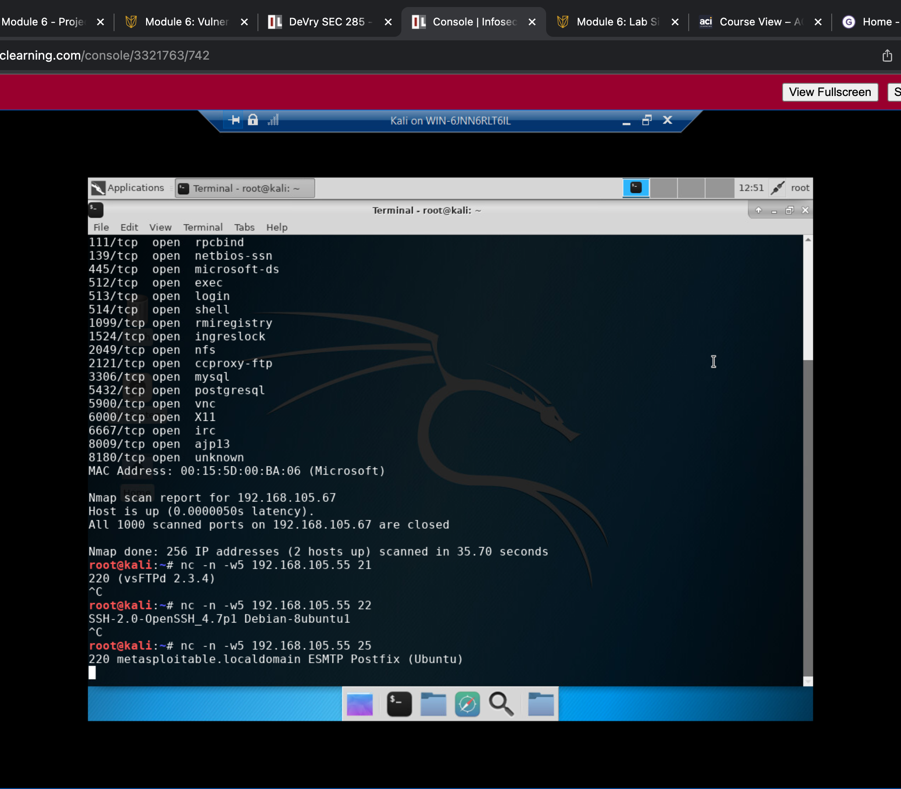
NetCat
This screenshot should include the scan result showing both the Kali and Linux Server VMs.

Slide 17
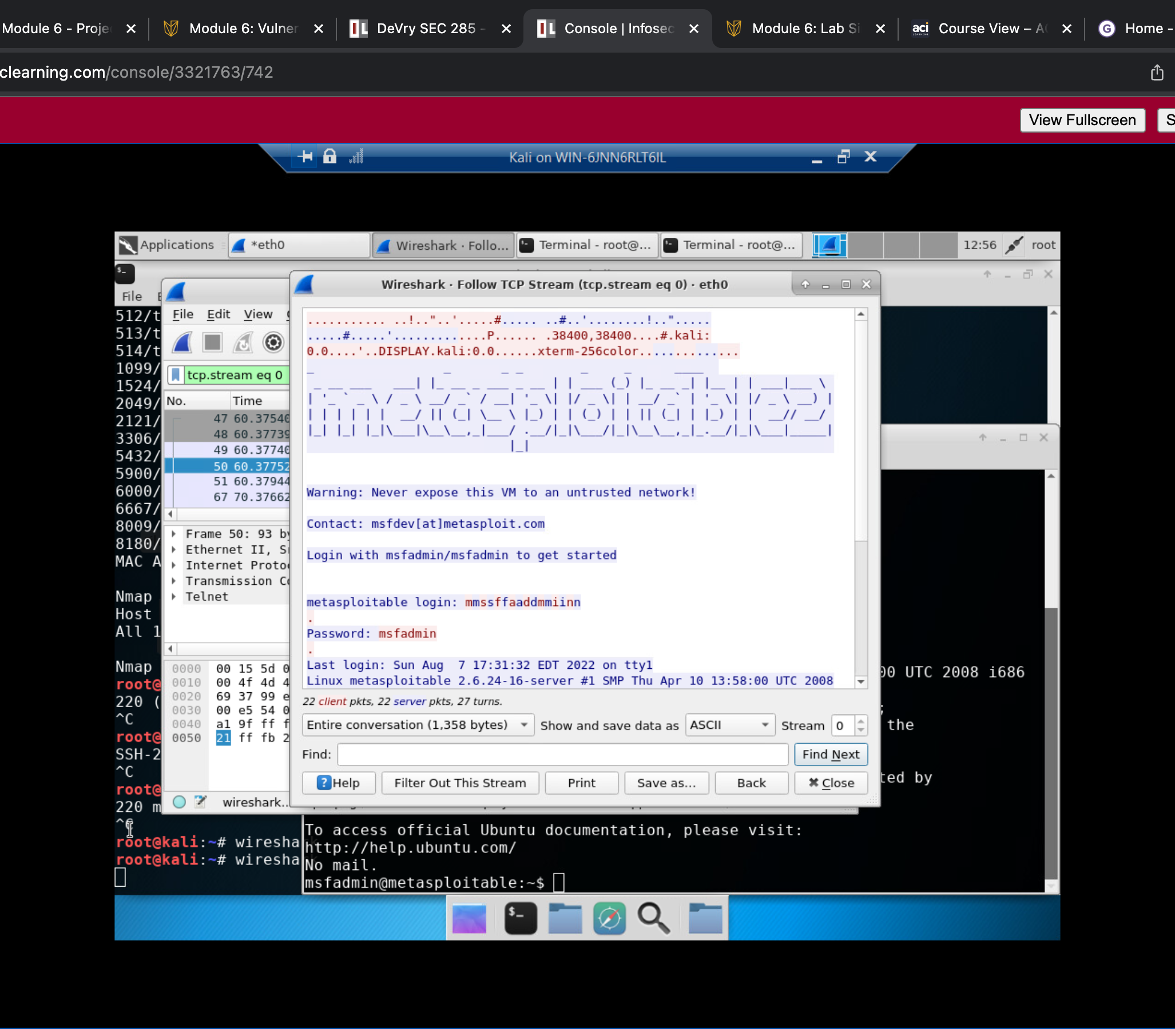
Wireshark
This screenshot should include the Wireshark—Follow TCP Steam window showing the Telnet username and password.

Slide 18
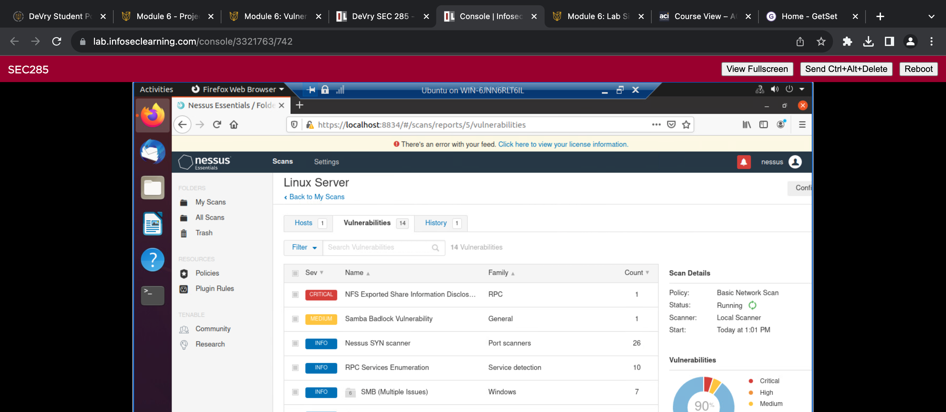
Nessus
This screenshot should include the high-level view of the Nessus vulnerability scan report (showing categories of vulnerability in different colors).

Slide 19
Challenges
Some of the Challenges for me where simply getting use to the Linux commands when working in the virtual environment
Another challenge was working with tools that are common for packet sniffing like wire shark .

Slide 20
Career Skills
I believe I developed a solid foundation of security knowledge with some hands-on work as well
Learning and executing highly renowned commands like Nmap in actual virtual environments instead of just reading about them is one that will help me in the long run

Slide 21
Conclusion
In conclusion I feel there was great value in this class it has motivated me greatly and helped me see that I need to get more hands on if I want to be successful truly as a security professional I want to be in the future .

